Slide 1

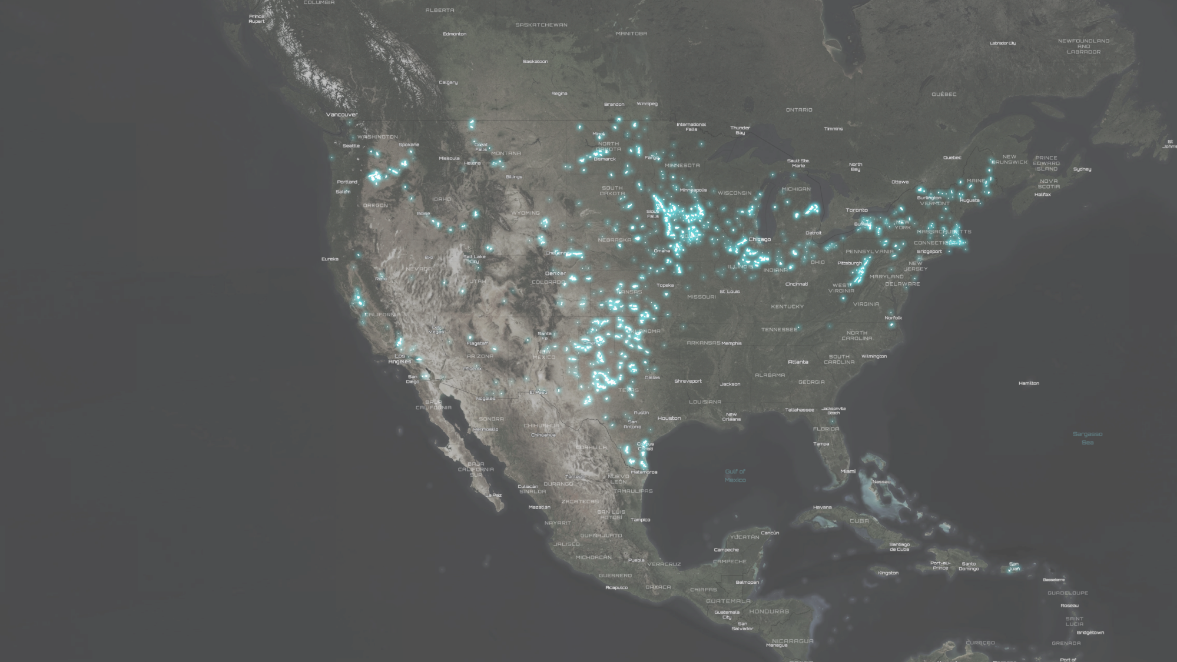



United States Wind Turbine Database
Wind & Wildlife Training, May 22-23, 2024
Jay Diffendorfer, Chris Garrity, Louisa Kramer
-United States Geological Survey
Ben Hoen & Joe Rand
-Lawrence Berkeley National Laboratory
John Hensley
-American Clean Power

Slide 2
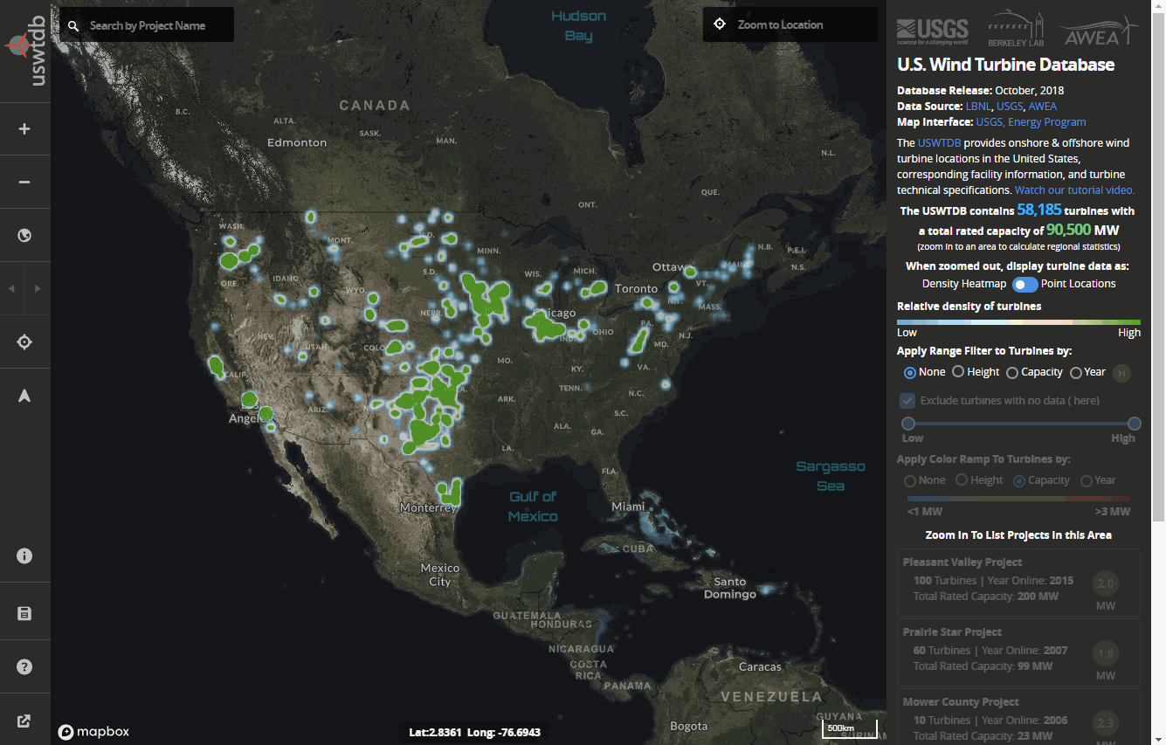





The U.S. Wind Turbine Database At a Glance
Provides The Locations, Corresponding Project Information, and Turbine Technical Specifications for Wind Turbines (Land-Based and Offshore) in the United States
Jointly funded by the DOE (WETO), LBNL, USGS, and ACP Association
The USWTDB Contains Over 70,000 Wind Turbines. Updated Quarterly
Available for Download in a Variety of Tabular and Geospatial File Formats
Visualize, Inspect, and Interact with the USWTDB through a Mobile Web App
Visualize, Inspect, and Interact with the USWTDB through an API
Visit: Discover, interact, and download the USWTDB in a variety of tabular/geospatial file formats @ https://eerscmap.usgs.gov/uswtdb/
Notes:
U.S. Wind turbine database at a glance.

Slide 3









Meet The USWTDB Team
Lawrence Berkeley
National Laboratory
Ben Hoen
Joe Rand
United States
Geological Survey
Jay Diffendorfer
Louisa Kramer
Chris Garrity
American Clean Power
John Hensley
Notes:
Ben Hoen, Research Scientist, LBNL. PI for the project.
Joseph Rand is also a researcher at LBNL and he headed up the database management side of the project
Hannah Hunt, Deputy Director, Electricity Policy & Demand, AWEA. She was the lead at AWEA focusing on this project.
Jay Diffendorfer, Research Ecologist, USGS. Headed up USGS efforts, and also was the PI for a project to develop a similar database back in 2013.
Louisa Kramer, Physical Scientist, USGS. Her work focused on the visual verification and developing the metadata for the database
Chris Garrity, Geographic Information Sciences, USGS. Led the website and online viewer development. He also has is developing the video for the viewer, which will be released in the coming weeks.
========================================================
Ben Hoen, Research Scientist, LBNL. Ben's work focuses on the intersection of renewable energy and the public. He has lead efforts exploring property value, social and systems impacts of the growing deployments of wind and solar energy.
Joseph Rand is a research affiliate in the Electricity Markets and Policy Group at LBNL Joe conducts research and analysis on renewable energy, including: cost and market analysis; spatial data analysis; and research related to public acceptance of renewable energy.
Hannah Hunt, Deputy Director, Electricity Policy & Demand, AWEA. Hannah performs policy and market analysis on the U.S. wind industry, identifying emerging opportunities to increase wind demand through issues such as utility engagement, corporate procurement, electrification, and carbon policy.
Jay Diffendorfer, Research Ecologist, USGS. Jay is an applied ecologist performing research on topics related to the energy-environment nexus, migratory species, ecosystem services, and land change science.
Louisa Kramer, Physical Scientist, USGS. Louisa provides GIS support, and spatial and data analysis, of energies and land changes.
Chris Garrity, Geographic Information Sciences, USGS. Chris leads a range of geospatial efforts at the USGS, from geospatial application and database development to work leveraging open data, geospatial modeling, remote sensing, data visualization, and geospatial-specific strategy.

Slide 4

Background: Early data and need
2014
  Public data: FAA and USGS
    USGS not updated.
  Private data: AWEA (now ACP), and LBNL
  Wind Turbine Radar Interference Mitigation Working Group (WTRIM) established.
2015
  DOE proposes a collaborative dataset.

Slide 5




Background
Wind Energy Technologies Office
Office Of Energy Efficiency & Renewable Energy
USGS Energy Resources Program

Slide 6
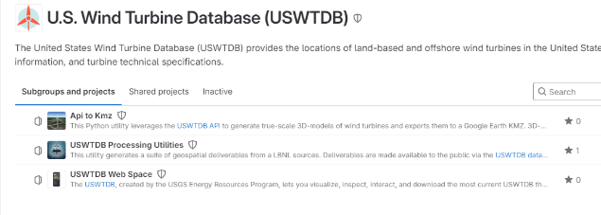
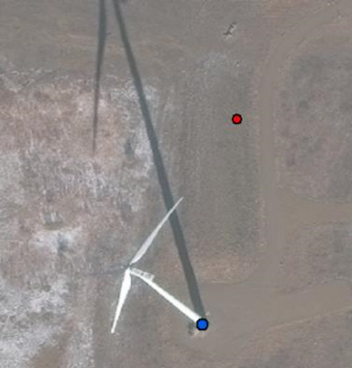
Generalized workflow for quarterly updates
1. Merge, clean, check for duplicates, decommissioned
3. Additional QA/QC. Scripts, field codes, consistency, etc
FAA Digital Obstacle File (DOF)
FAA Obstruction Evaluation – Airport Airspace Analysis (OE-AAA)
American Clean Power member database
4. Update metadata, log-book, API, and web application. Post it for the public
2. Visual verification using satellite imagery
MOVE
  Gory details: Rand et al. (2020). A continuously updated, geospatially rectified database of utility-scale wind turbines in the United States. Scientific Data

Slide 7
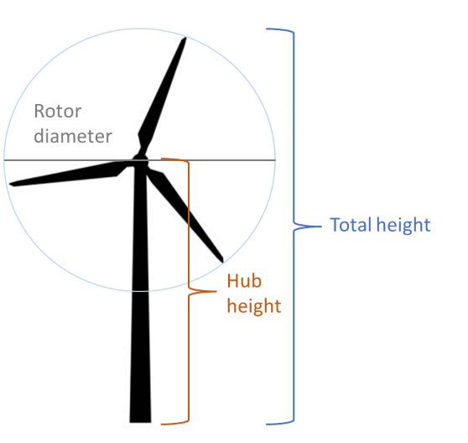
What’s in the data?
Field | Description
case_id | unique uswtdb id
faa_ors | faa digital obstacle file (dof) for obstacle repository system (ors)
faa_asn | faa obstruction evaluation - airport airspace analysis (oe-aaa) aeronautical study number (asn)
usgs_pr_id | usgs id from prior turbine dataset
eia_id | eia plant id from eia form 860
t_state | state where turbine is located
t_county | county where turbine is located
t_fips | state and county fips where turbine is located
xlong | longitude (decimal degrees - NAD 83 datum)
ylat | latitude (decimal degrees - NAD 83 datum)
p_name | project name
p_year | year project became operational
p_tnum | number of turbines in project
p_cap | project capacity (MW)
t_manu | turbine original equipment manufacturer
t_model | turbine model
t_cap | turbine capacity (kW)
t_hh | turbine hub height (meters)
t_rd | turbine rotor diameter (meters)
t_rsa | turbine rotor swept area (meters^2)
t_ttlh | turbine total height - calculated (meters)
retrofit | indicator of whether the turbine has been partially retrofitted after initial construction
retrofit_year | year in which turbine was retrofitted
t_conf_atr | turbine characteristic confidence (0-3)
t_conf_loc | location confidence (0 -3)
t_img_date | date of image used to visually verify turbine location
t_img_srce | source of image used to visually verify turbine location
Link to source data
Turbine location
Project level information
Turbine specifications
QA/QC information
Imagery used

Slide 8
Access
1. USGS information page.
https://eerscmap.usgs.gov/uswtdb/
2. Web application and viewer.
https://eerscmap.usgs.gov/uswtdb/viewer/#3/37.25/-96.25
3. LBNL information page.
https://emp.lbl.gov/publications/us-wind-turbine-database-files
4. USWTDB API (Application Programming Interface)
https://eerscmap.usgs.gov/uswtdb/api-doc/
5. Data download/Web Services
https://eerscmap.usgs.gov/uswtdb/data/

Slide 9
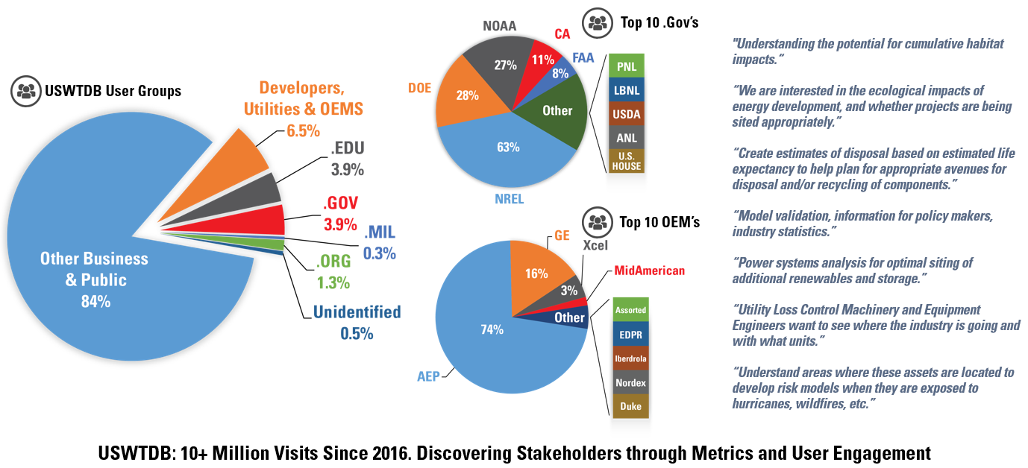
Users

Slide 10

Questions and Comments
USWTDB Team at: uswtdb@lbl.gov
Contact info:
Ben Hoen: bhoen@lbl.gov
Joe Rand: jrand@lbl.gov
Jay Diffendorfer: jediffendorfer@usgs.gov
Louisa Kramer: lkramer@usgs.gov
Chris Garrity: cgarrity@usgs.gov

