Slide 1
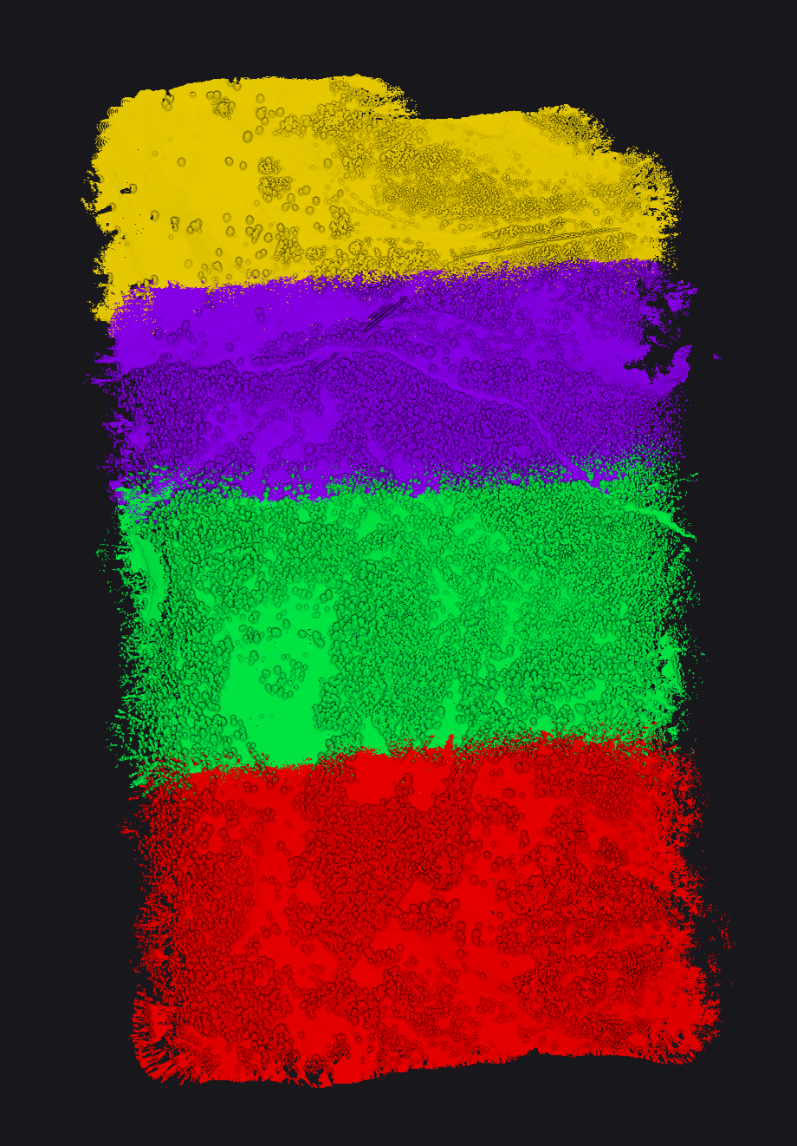
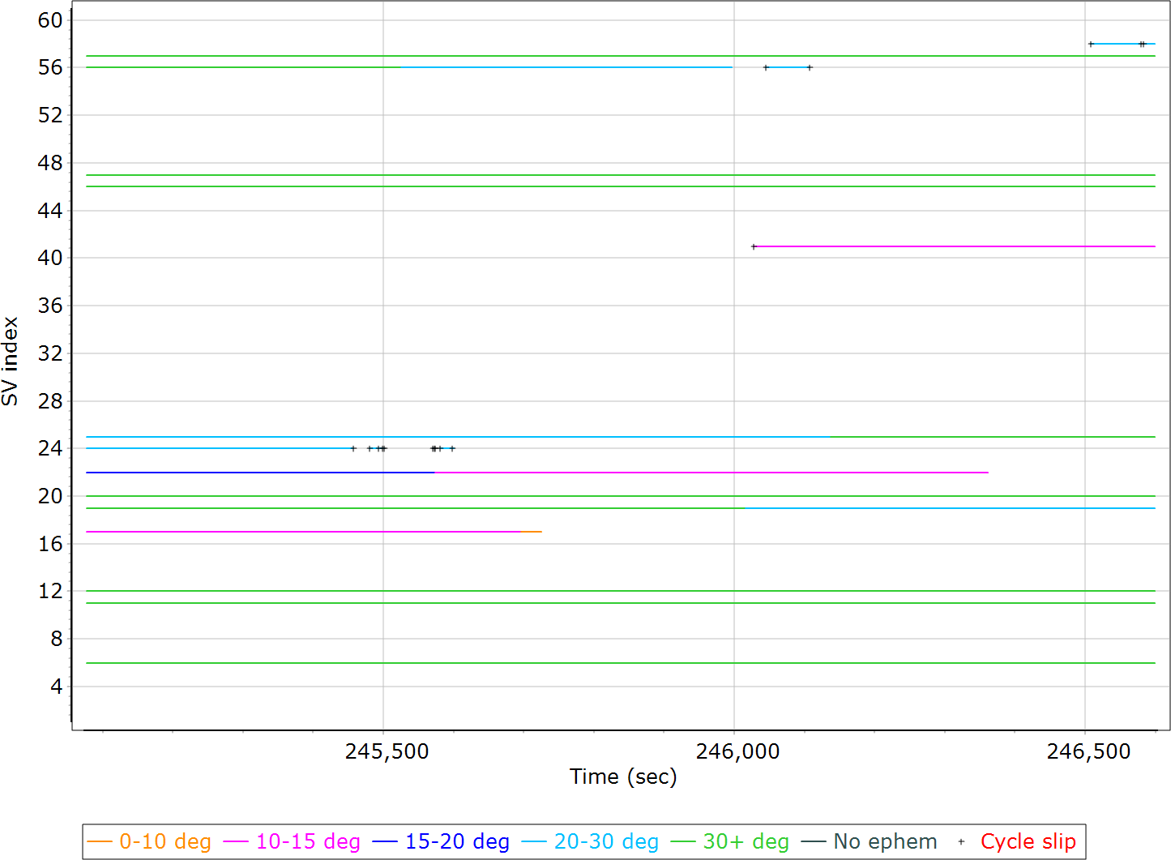
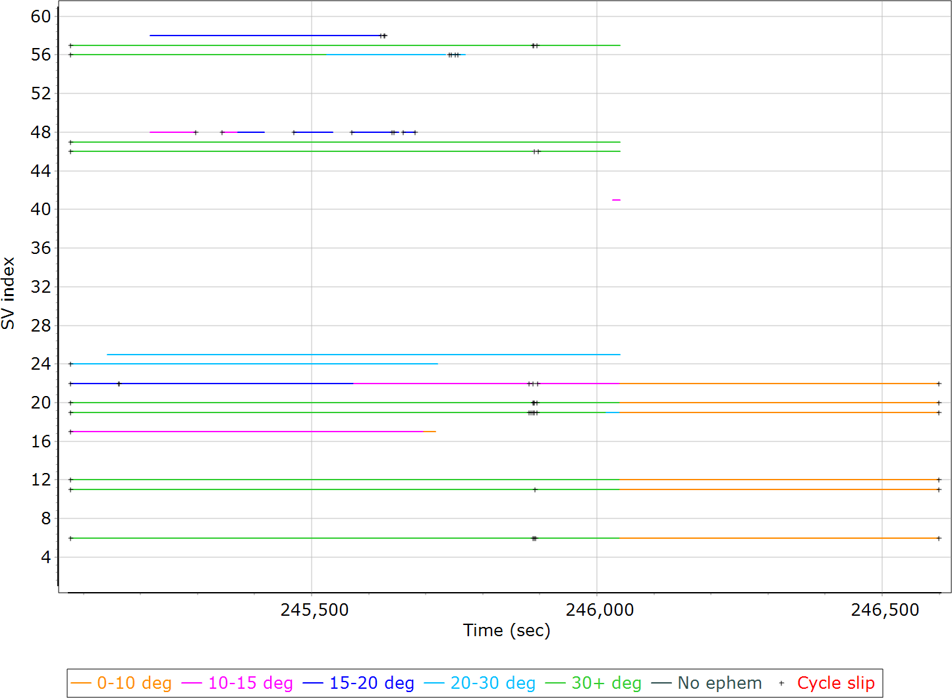
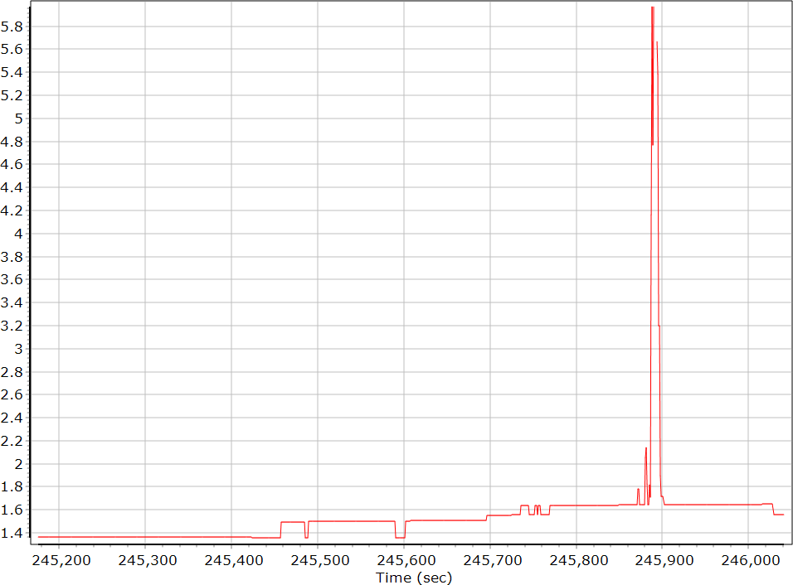
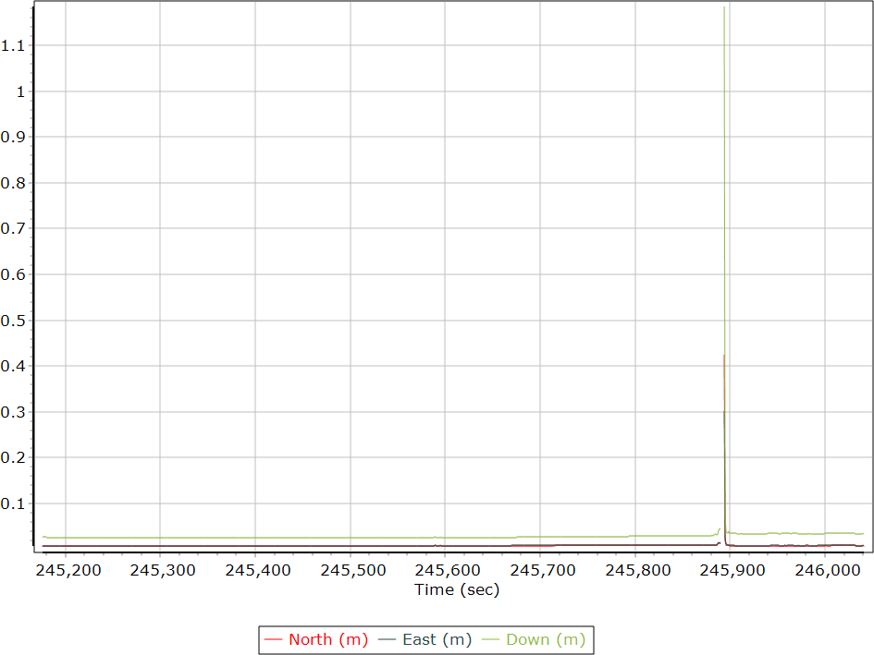
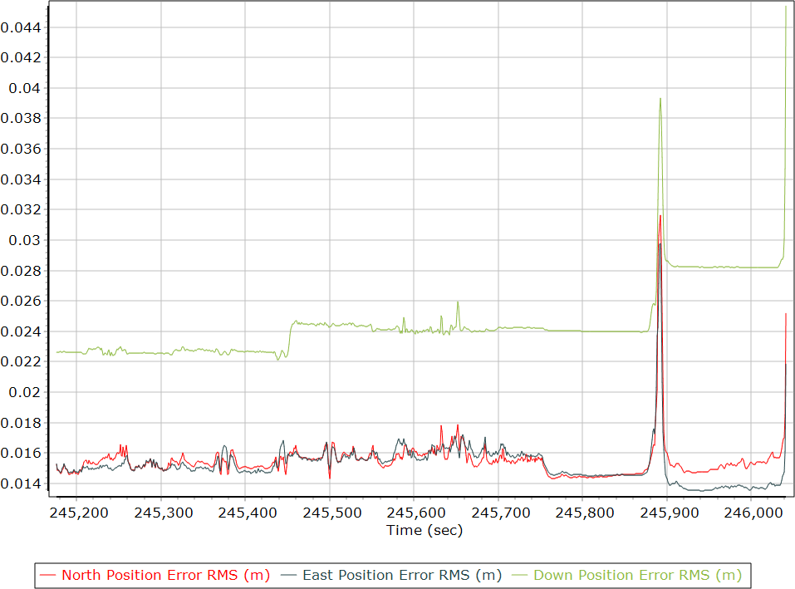
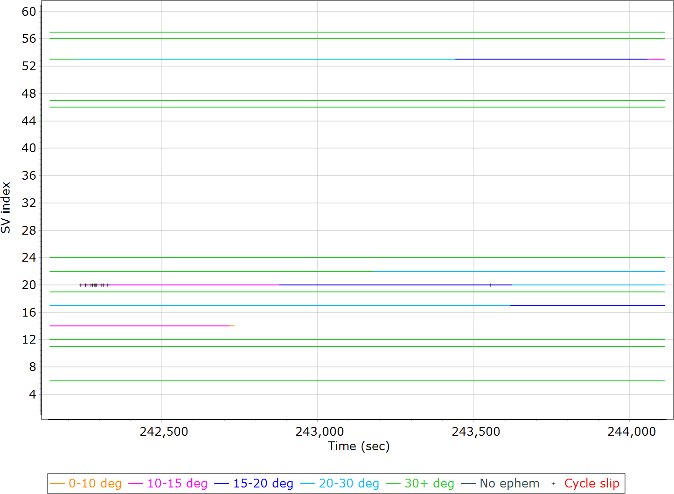
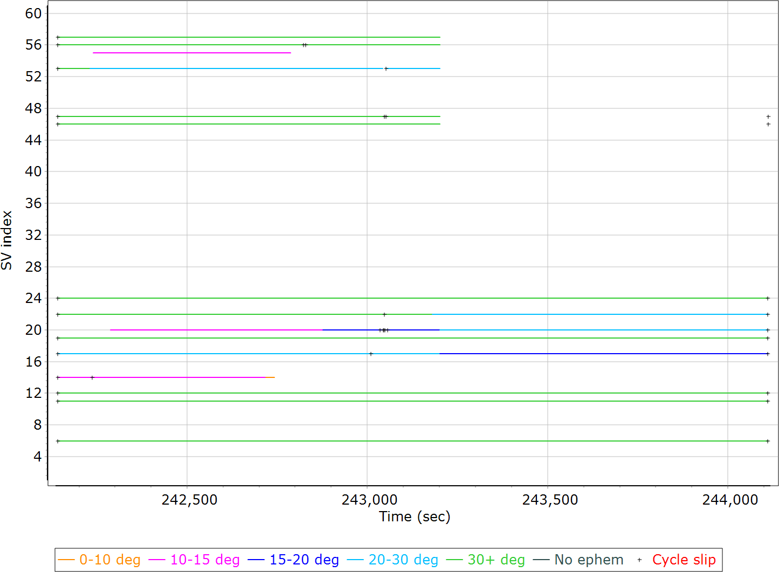
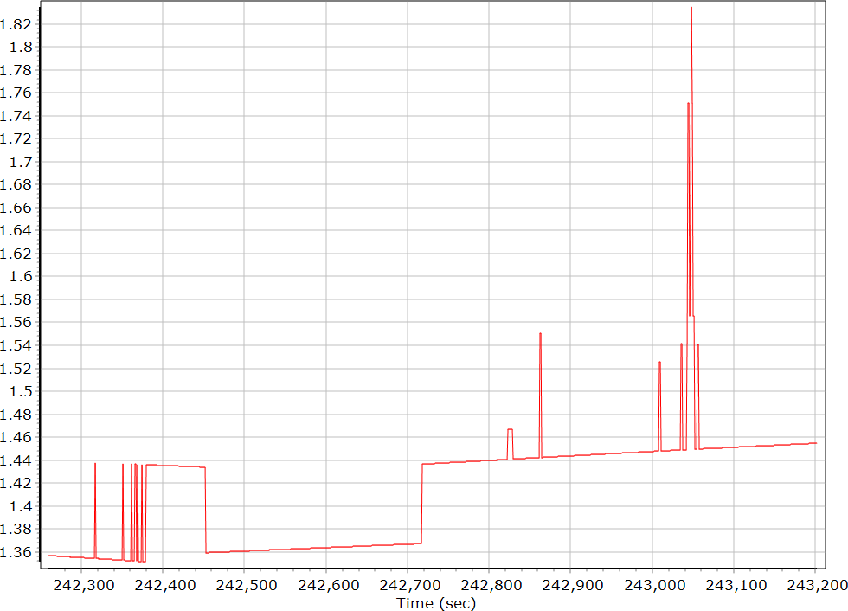
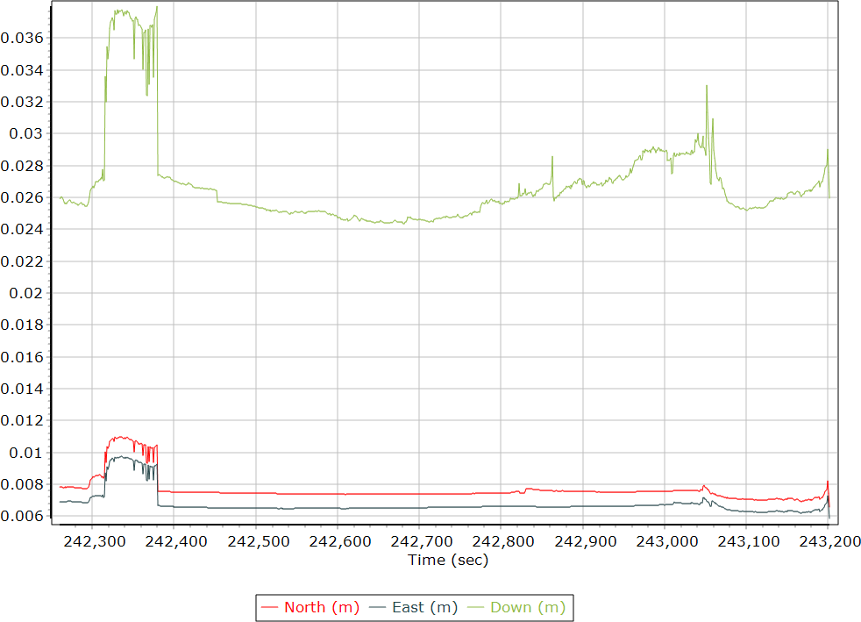
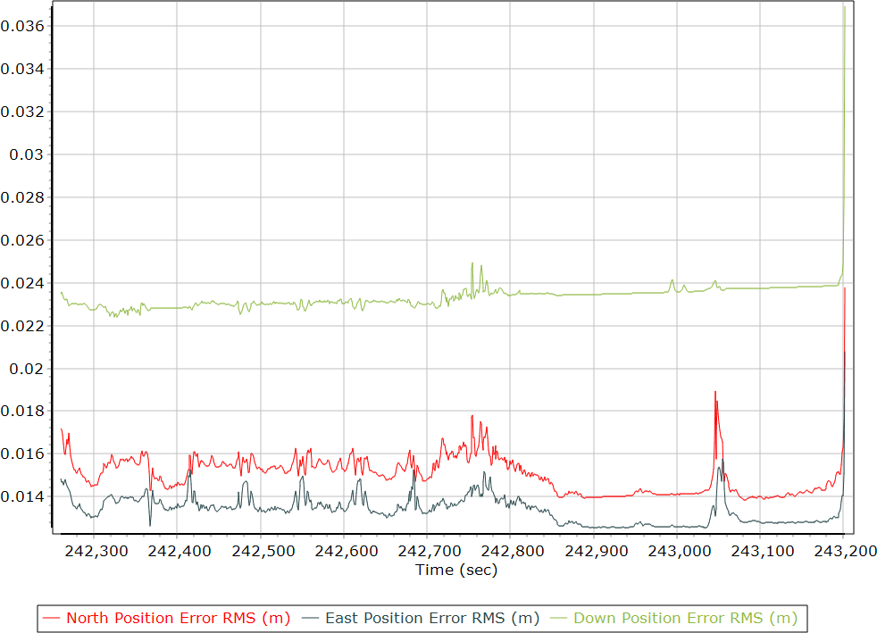
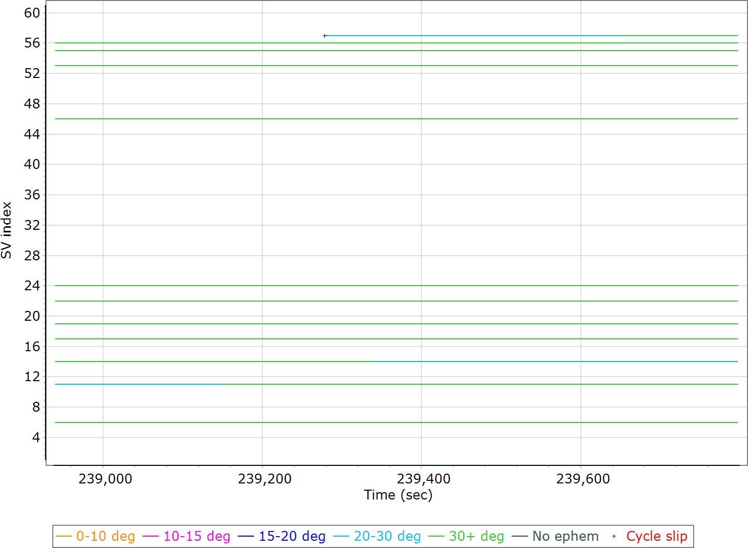
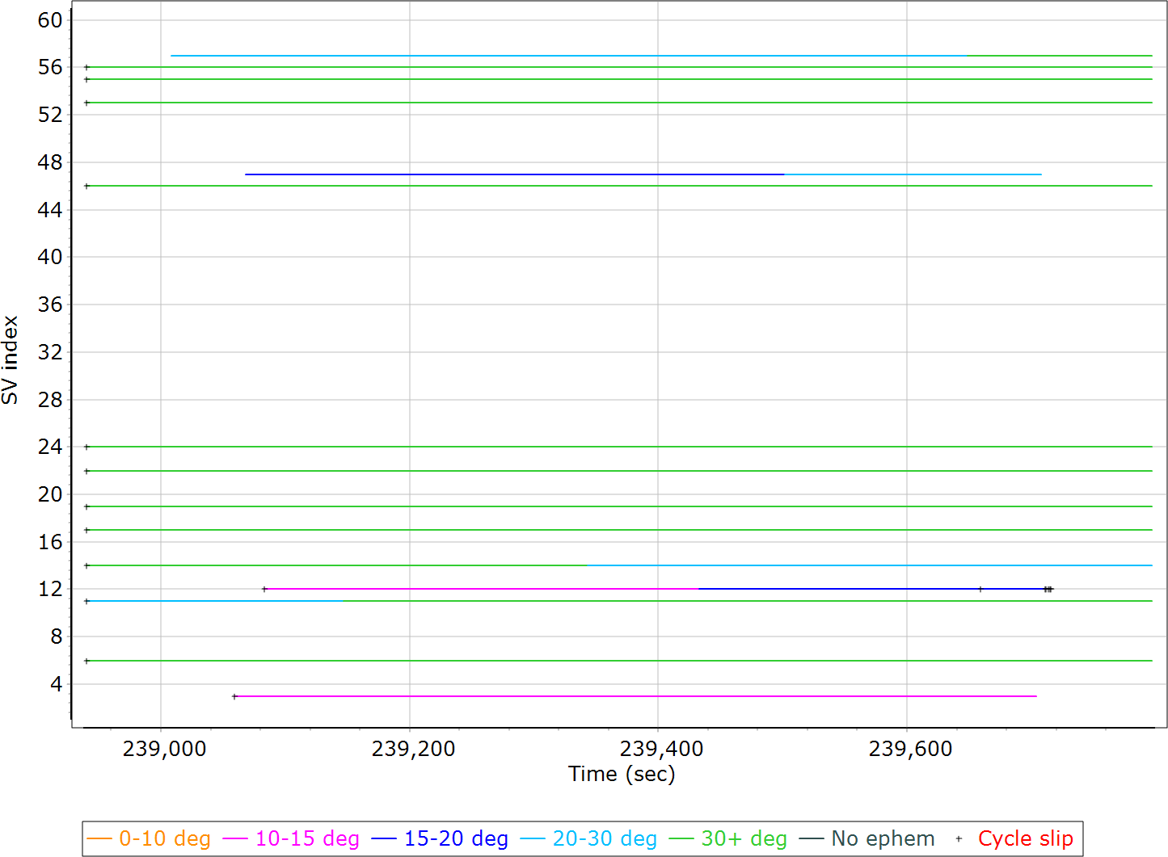
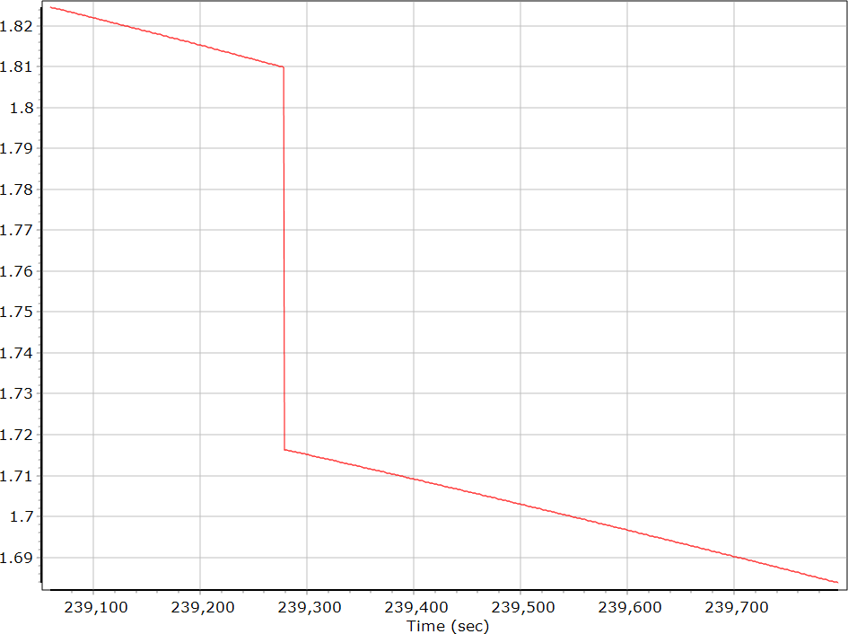
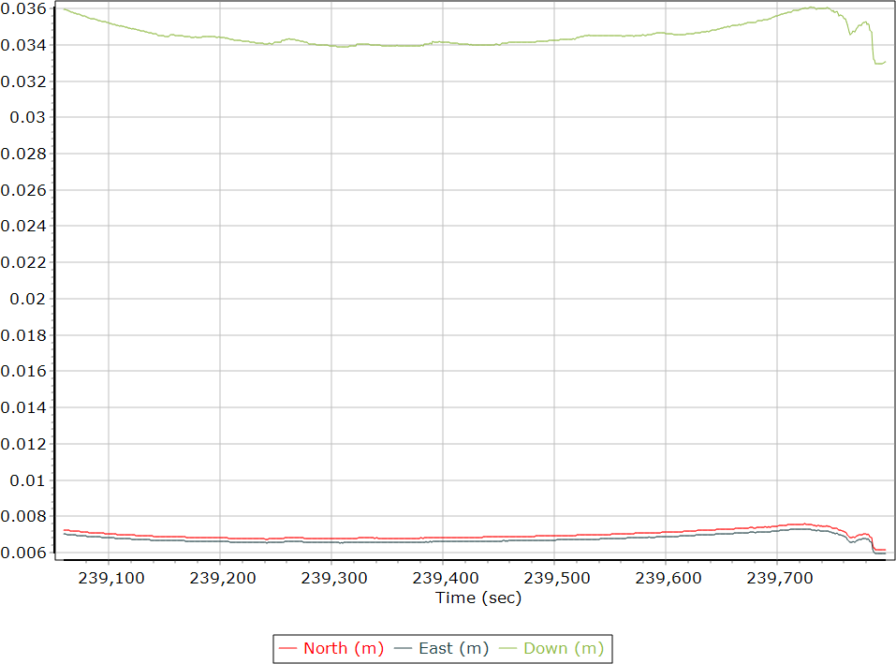
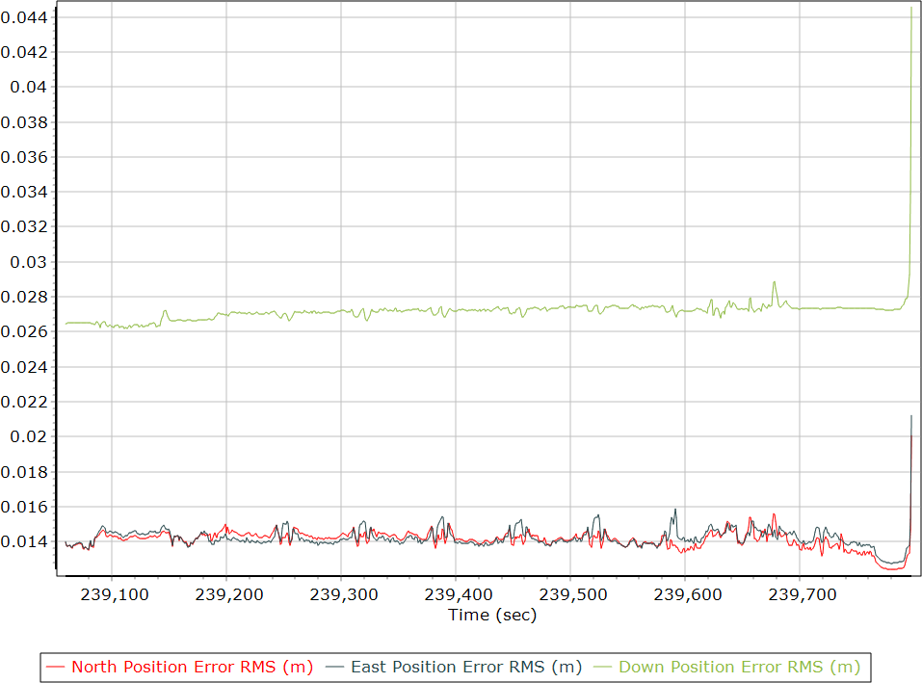
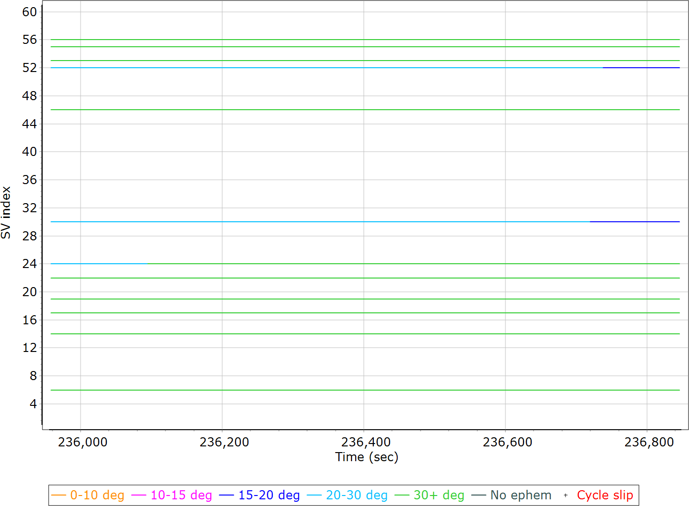
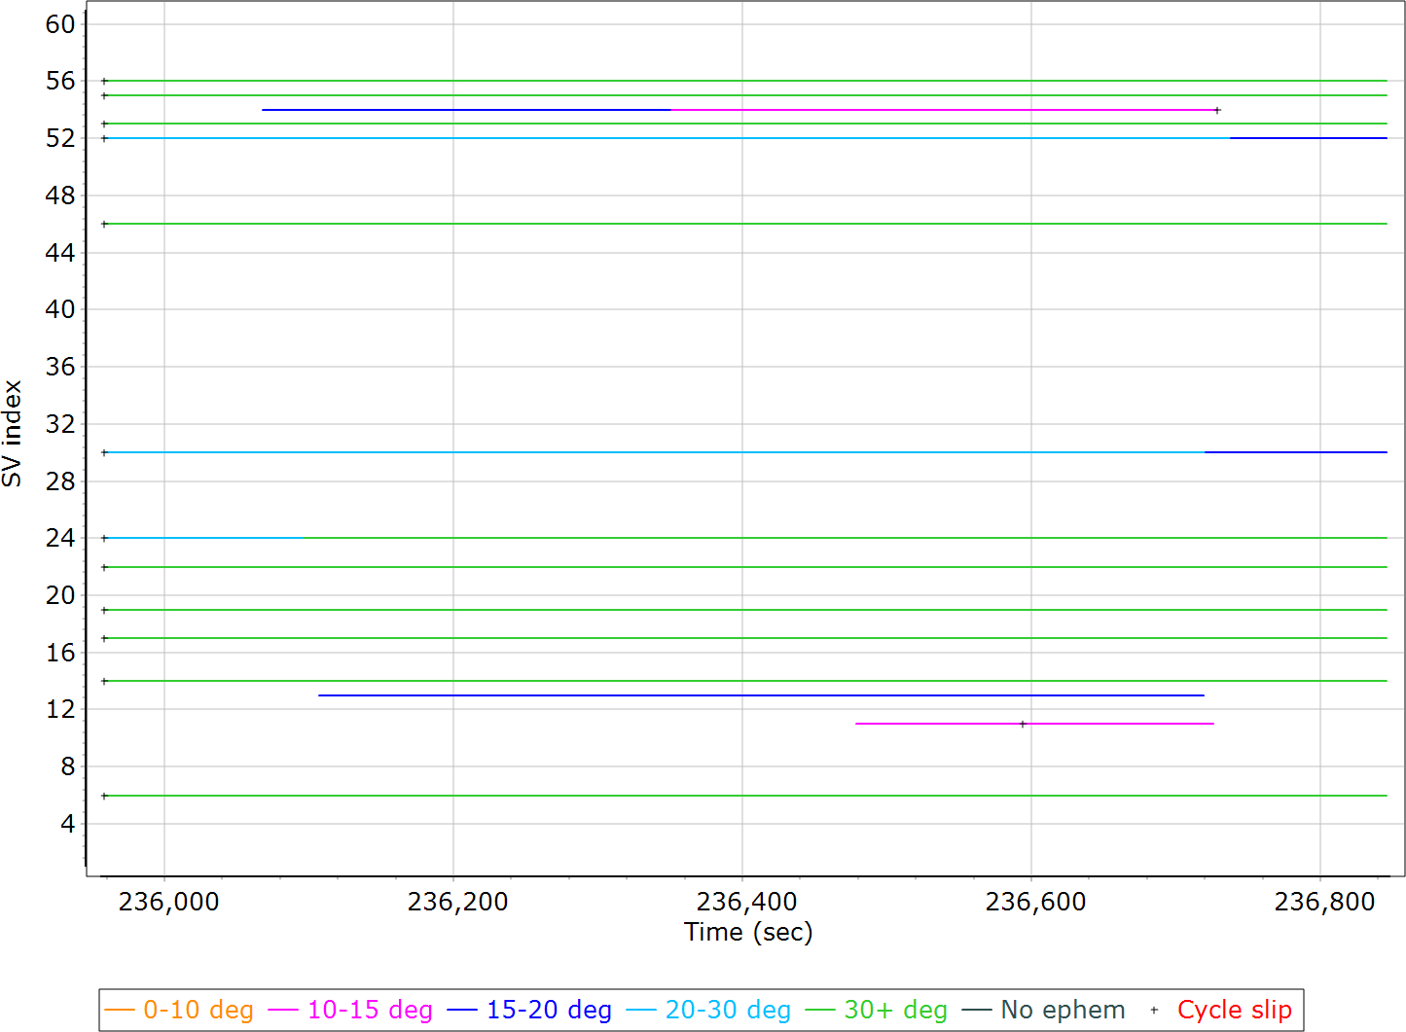
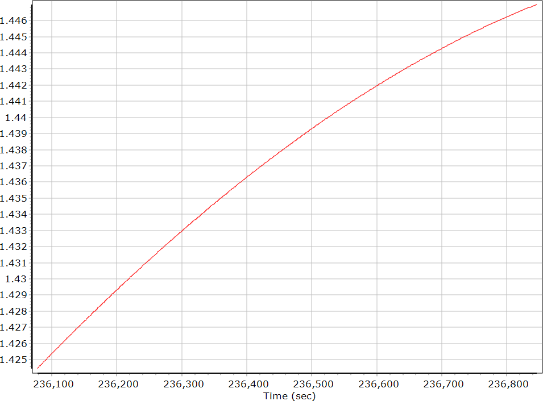
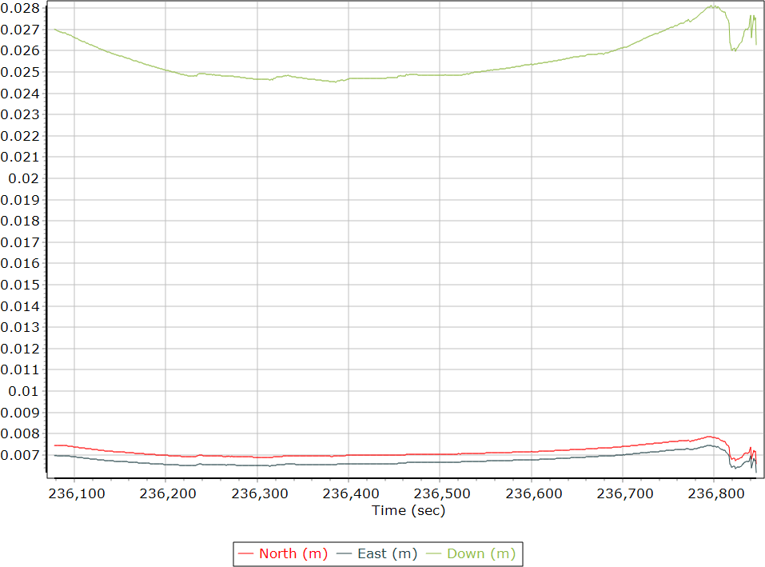
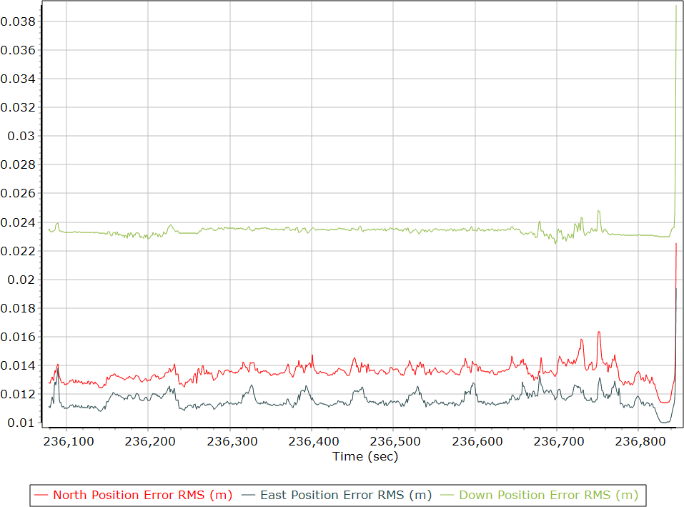
Reviewing GNSS quality for Coal Bank Pass, CO- UAS Lidar 04/09/2024
Flight 4
Base Observables & Satellite Data
Base GPS/GLONASS L1 Satellite Lock/Elevation
Rover Observables & Satellite Data
GPS/GLONASS L1 Satellite Lock/Elevation
Base Station Information
Rover Data QC
Raw IMU Import QC Summary
PDOP - Base
Estimated Position Accuracy -Base
Smoothed Performance Metrics
Position Error RMS (m)
PosPac Report Page 28
Statistics | Min | Max | Mean
Baseline length (km) | 0.01 | 1.23
Number of GPS SV | 3 | 9 | 8
Number of GLONASS SV | 0 | 3 | 3
Number of QZSS SV | 0 | 0 | 0
Number of BEIDOU SV | 0 | 2 | 2
Number of GALILEO SV | 3 | 5 | 5
Total number of SV | 7 | 19 | 18
PDOP | 1.36 | 5.97 | 1.53
QC Solution Gaps | 3.00 | 3.00
Solution Type | Fixed | Float | No solution
Epoch (sec) | 906.00 | 0.00 | 3.00
Percentage | 99.67 | 0.00 | 0.33
PosPac Report Page 4
IMU data input file | imu_Mission 1.dat
IMU data check log file | imudt_Mission 1.log
IMU Records Processed | 192677
Termination Status | Warnings
IMU Anomalies | 1
IMU Failure Messages
Flight 3
Base Observables & Satellite Data
Base GPS/GLONASS L1 Satellite Lock/Elevation
Rover Observables & Satellite Data
GPS/GLONASS L1 Satellite Lock/Elevation
Base Station Information
Rover Data QC
Raw IMU Import QC Summary
PDOP - Base
Estimated Position Accuracy -Base
Smoothed Performance Metrics
Position Error RMS (m)
PosPac Report Page 28
PosPac Report Page 29
PosPac Report Page 30
PosPac Report Page 44
Statistics | Min | Max | Mean
Baseline length (km) | 0.01 | 1.29
Number of GPS SV | 6 | 9 | 8
Number of GLONASS SV | 3 | 4 | 4
Number of QZSS SV | 0 | 0 | 0
Number of BEIDOU SV | 0 | 2 | 2
Number of GALILEO SV | 4 | 6 | 5
Total number of SV | 15 | 20 | 19
PDOP | 1.35 | 1.83 | 1.41
QC Solution Gaps | 0.00 | 0.00
Solution Type | Fixed | Float | No solution
Epoch (sec) | 1023.00 | 0.00 | 0.00
Percentage | 100.00 | 0.00 | 0.00
PosPac Report Page 4
IMU data input file | imu_Mission 1.dat
IMU data check log file | imudt_Mission 1.log
IMU Records Processed | 212588
Termination Status | Normal
IMU Anomalies | 0
Flight 2
Base Observables & Satellite Data
Base GPS/GLONASS L1 Satellite Lock/Elevation
Rover Observables & Satellite Data
GPS/GLONASS L1 Satellite Lock/Elevation
Base Station Information
Rover Data QC
Raw IMU Import QC Summary
PDOP - Base
Estimated Position Accuracy - Base
Smoothed Performance Metrics
Position Error RMS (m)
PosPac Report Page 28
PosPac Report Page 22
PosPac Report Page 4
PosPac Report Page 29
PosPac Report Page 30
PosPac Report Page 44
Statistics | Min | Max | Mean
Baseline length (km) | 0.03 | 1.44
Number of GPS SV | 7 | 7 | 7
Number of GLONASS SV | 4 | 5 | 5
Number of QZSS SV | 0 | 0 | 0
Number of BEIDOU SV | 2 | 2 | 2
Number of GALILEO SV | 5 | 5 | 5
Total number of SV | 18 | 19 | 19
PDOP | 1.68 | 1.83 | 1.75
QC Solution Gaps | 0.00 | 0.00
Solution Type | Fixed | Float | No solution
Epoch (sec) | 852.00 | 0.00 | 0.00
Percentage | 100.00 | 0.00 | 0.00
PosPac Report Page 4
IMU data input file | imu_Mission 1.dat
IMU data check log file | imudt_Mission 1.log
IMU Records Processed | 171400
Termination Status | Normal
IMU Anomalies | 0
Flight 1
Base Observables & Satellite Data
Base GPS/GLONASS L1 Satellite Lock/Elevation
Rover Observables & Satellite Data
GPS/GLONASS L1 Satellite Lock/Elevation
Base Station Information
Rover Data QC
Raw IMU Import QC Summary
PDOP -Base
Estimated Position Accuracy - Base
Smoothed Performance Metrics
Position Error RMS (m)
PosPac Report Page 28
PosPac Report Page 22
PosPac Report Page 4
PosPac Report Page 29
PosPac Report Page 30
PosPac Report Page 44
Statistics | Min | Max | Mean
Baseline length (km) | 0.03 | 1.66
Number of GPS SV | 7 | 7 | 7
Number of GLONASS SV | 5 | 5 | 5
Number of QZSS SV | 0 | 0 | 0
Number of BEIDOU SV | 2 | 2 | 2
Number of GALILEO SV | 4 | 5 | 5
Total number of SV | 18 | 19 | 19
PDOP | 1.42 | 1.68 | 1.44
QC Solution Gaps | 0.00 | 0.00
Solution Type | Fixed | Float | No solution
Epoch (sec) | 852.00 | 0.00 | 0.00
Percentage | 100.00 | 0.00 | 0.00
PosPac Report Page 4
IMU data input file | imu_Mission 1.dat
IMU data check log file | imudt_Mission 1.log
IMU Records Processed | 177664
Termination Status | Normal
IMU Anomalies | 0

