Slide 1
QUAKES Camera Layout
September 2021

Slide 2
$$\hat{x}$$
$$\hat{z}$$
$$\hat{x}$$
$$\hat{z}$$
2
3
4
“main plate”
1
$$\hat{y}$$
$$\hat{y}$$
5
6
7
8
arrangement is symmetric
each main plate is turned about $y$-axis by 11.3° (22.6° between the plates)
cameras 1,2,3,4 all planar. as well as 5,6,7,8.
there is 17.1° between cameras 2 & 3
there is 40.5° between cameras 1 & 4

Slide 3
$$\hat{x}$$
$$\hat{z}$$
$$\hat{x}$$
$$\hat{z}$$
2
3
4
“main plate”
1
$$\hat{y}$$
$$\hat{y}$$
5
6
7
8
330070 (2) 330075 (3) 330074 (4) 330068
(5) 330076 (6) 330071 (7) 330077 (8) 330069

Slide 4
$$\hat{z}$$
$$\hat{x}$$
$$\hat{y}$$

Slide 5
View is normal to one main plate
Dimensions shown in inches

Slide 6
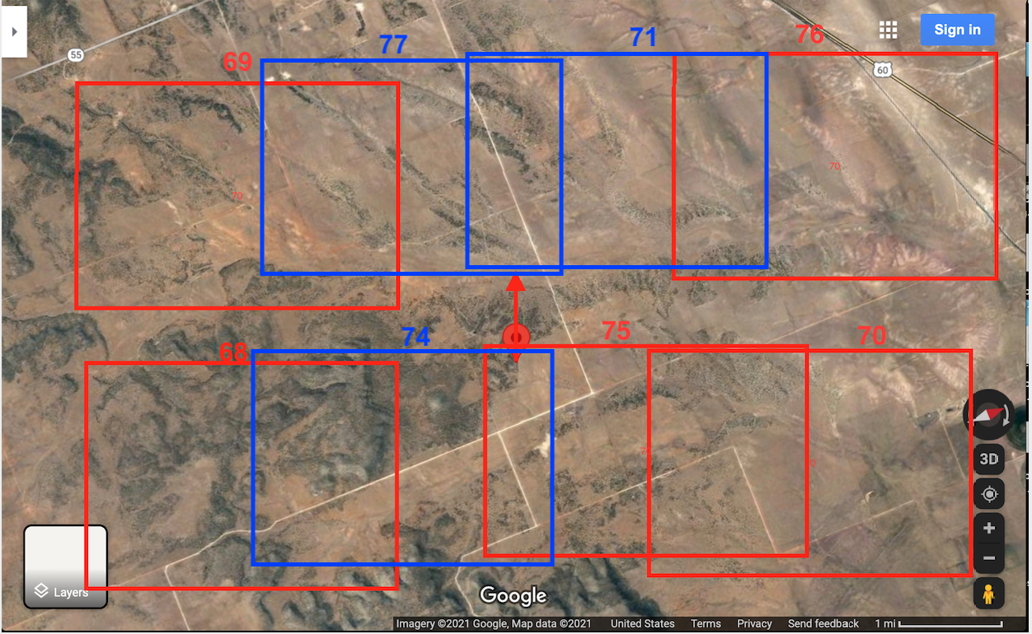
Sample overlay of camera FOVs onto Google map (box sizes and positions approximated only)

Slide 7
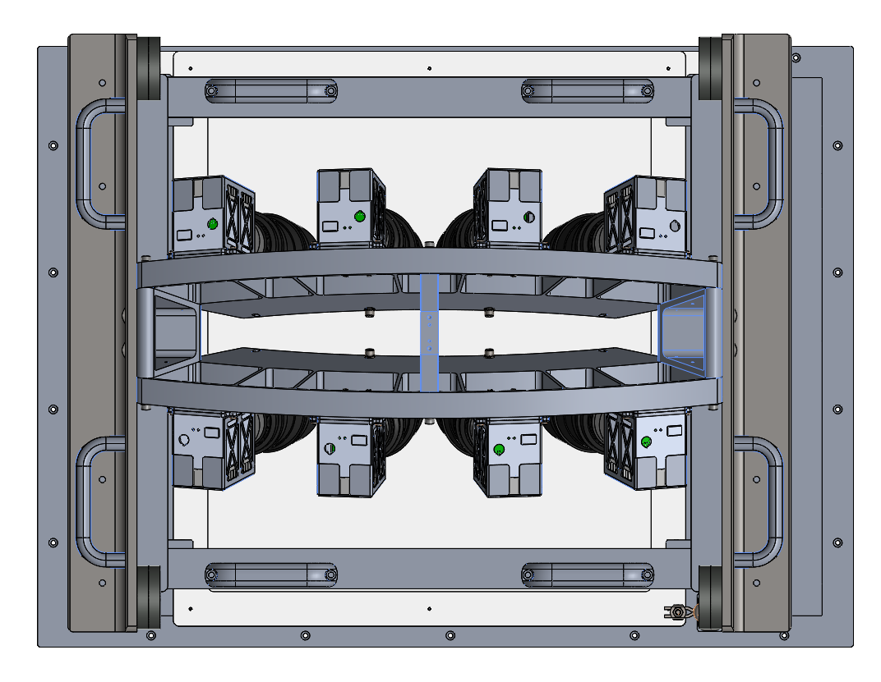
$$\hat{x}$$
$$\hat{z}$$
AFT Image Swath
1—68
2– 74
3—75
4—70
2
3
4
“main plate”
1
$$\hat{y}$$
Note: The top of 1—4 is in the direction of flight, while the bottom of 5—8 is opposite the direction of flight. The figure below (blue) has the image layout on the ground
FWD Image Swath
5
6
7
8
5—69
6– 77
7—71
8—76
X
5
X
6
X
7
X
8
X
1
X
2
X
3
X
4

Slide 8
Quakes camera extrinsic estimation
Using the overlapped area between adjacent camera, we have conduct an extrinsic estimation for the cameras array. The rotations from individual camera to the camera rig are
Camera 1
0.936659205673449 0.032428474433911 0.348737618379595
0.036854449671420 0.981051058091822 -0.190211910658439
-0.348297691589536 0.191016270152064 0.917715371218437
Camera 2
0.988886498748670 0.029131790166426 0.145790367975037
0.000000000000000 0.980614658553868 -0.195946144206210
-0.148672433869219 0.193768496487380 0.969716596318957
Camera 3
0.988477019418512 0.028431881182804 -0.148676865093066
-0.056320704272273 0.980764387438280 -0.186893538152316
0.140503239648664 0.193113553292417 0.971064362018815
Camera 4
0.939827236719807 0.034290737390967 -0.339924860004085
-0.096862830791666 0.980869001612957 -0.168859686384367
0.327631434893904 0.191625016644449 0.925168901263643
Then we can combine all four images into one virtual camera and the camera model is
Model = CAHV = perspective
Dimensions = 15856 3832
C = 0.000000 0.000000 0.000000
A = 0.000000 -0.195946 0.980615
H = 13731.698800 -1553.363058 7773.822706
V = 0.000000 14393.693280 4829.510407

Slide 9
Quakes camera extrinsic estimation
Using the overlapped area between adjacent camera, we have conduct an extrinsic estimation for the cameras array. The rotations from individual camera to the camera rig are
Camera 5
0.932946669516387 -0.101998609303234 0.345263371266759
0.026482039235308 0.975870907576308 0.216736414439597
-0.359039292329156 -0.193060237869944 0.913136644274765
Camera 6
0.988886498748670 -0.029131790166426 0.145790367975037
0.000000000000000 0.980614658553868 0.195946144206210
-0.148672433869219 -0.193768496487380 0.969716596318957
Camera 7
0.985913937622123 0.092348322170096 -0.139447104648356
-0.062633287617300 0.976935153712116 0.204144009766958
0.155083135397406 -0.192534393898470 0.968958063221241
Camera 8
0.930524818667874 0.165327222866278 -0.326788113649264
-0.088576532212689 0.967412186923075 0.237208470620018
0.355355821373866 -0.191782611234798 0.914845161895535
Then we can combine all four images into one virtual camera and the camera model is
Model = CAHV = perspective
Dimensions = 15856 3832
C = 0.000000 0.000000 0.000000
A = 0.000000 0.195946 0.980615
H = 13731.698800 1553.363058 7773.822706
V = 0.000000 15144.362959 -1072.775650

