Slide 1
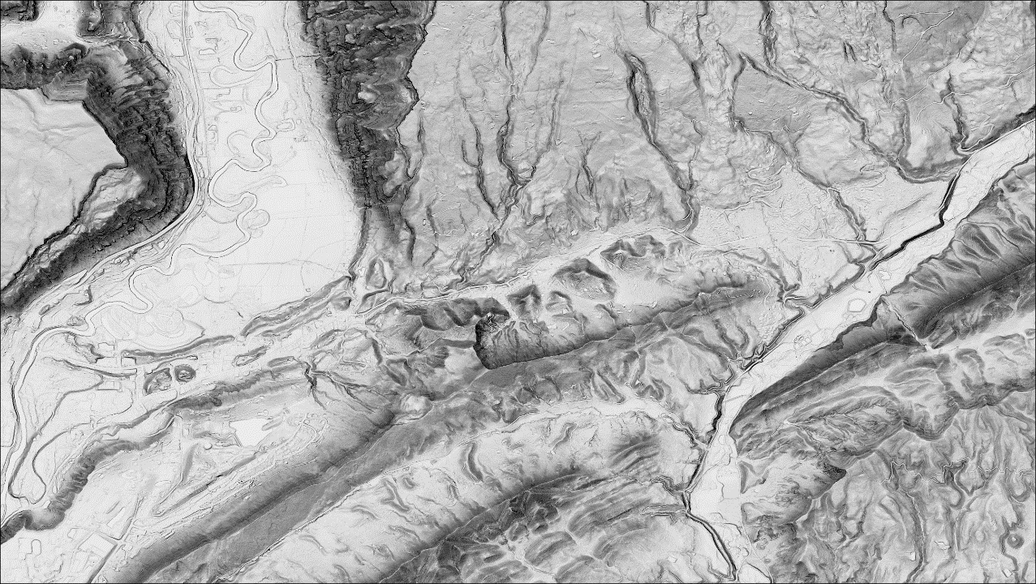
Advancing Topographic Analysis for NCGMP (ATAN)
Sam Johnstone, sjohnstone@usgs.gov
Quinn Miller, qmiller@contractor.usgs.gov
Ollie Smith, osmith@contractor.usgs.gov
Nessa Fakrai, nfakrai@contractor.usgs.gov
Emma Rahalski, erahalski@contractor.usgs.gov
Chelsea Scott, cpscott1@asu.edu
Cassie Brigham, cabrigha@asu.edu
Zhiang Cheng, zchen256@caltech.edu
Chris Crosby, chris.crosby@earthscope.org

Slide 2
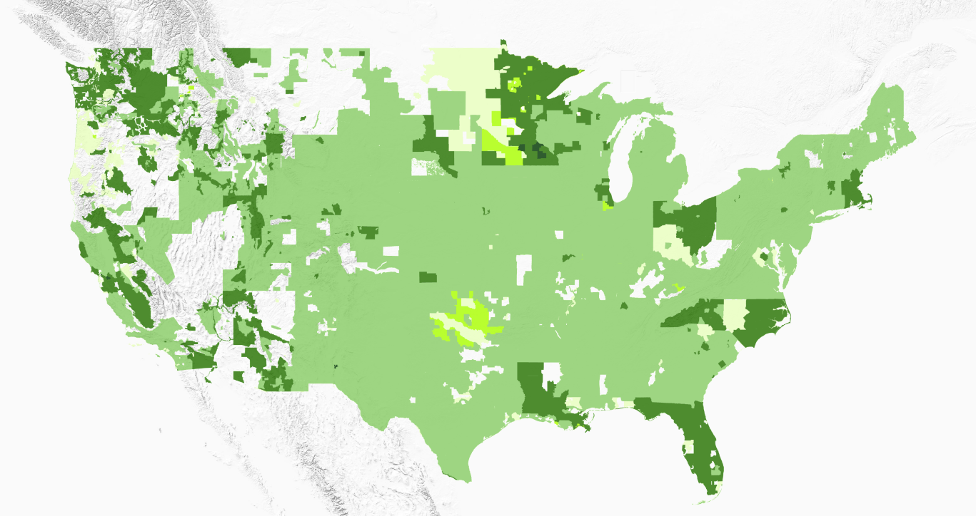
Widely available lidar from 3DEP has transformed our ability to visualize geologic features on Earth’s surface. However, it can be time consuming to collate and process.

Slide 3
Project structure and goals
The Advancing Topographic Analysis for NCGMP (ATAN) project was established with two goals; (1) make is easier for the community to use new and existing strategies and (2) develop new strategies for using topography data in geologic mapping.
Goal 1
Goal 2
Make it easier to
use high-resolution
topography in geologic
mapping
Strategy
Develop new
Approaches
for analyzing
topography
to aid geologic
mapping
Train people
to recognize
opportunities
and build
tools

Slide 4
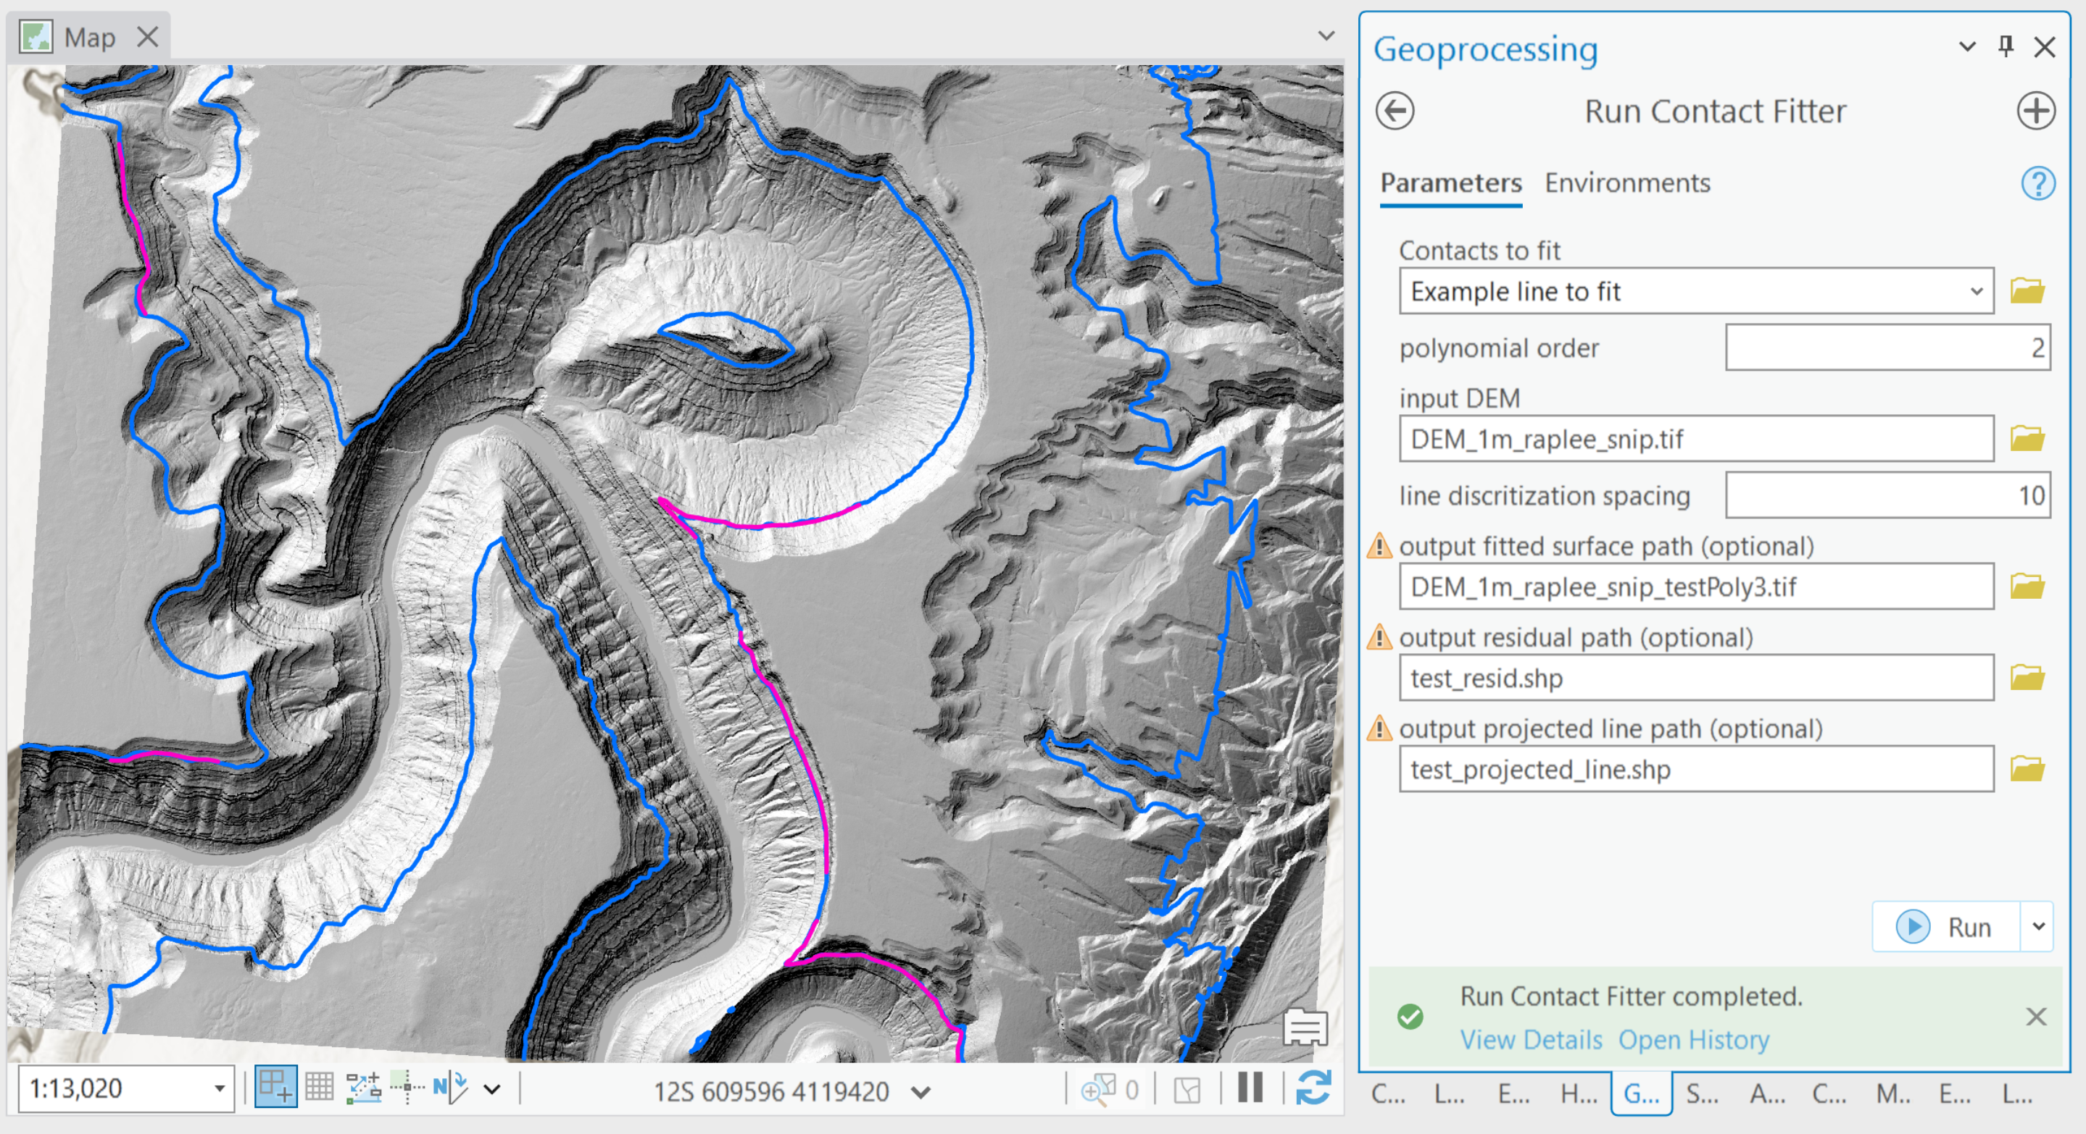
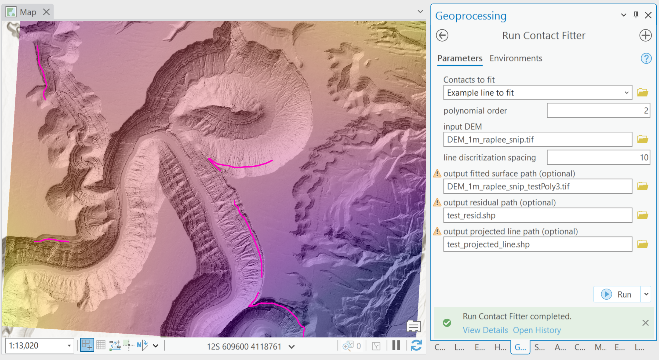
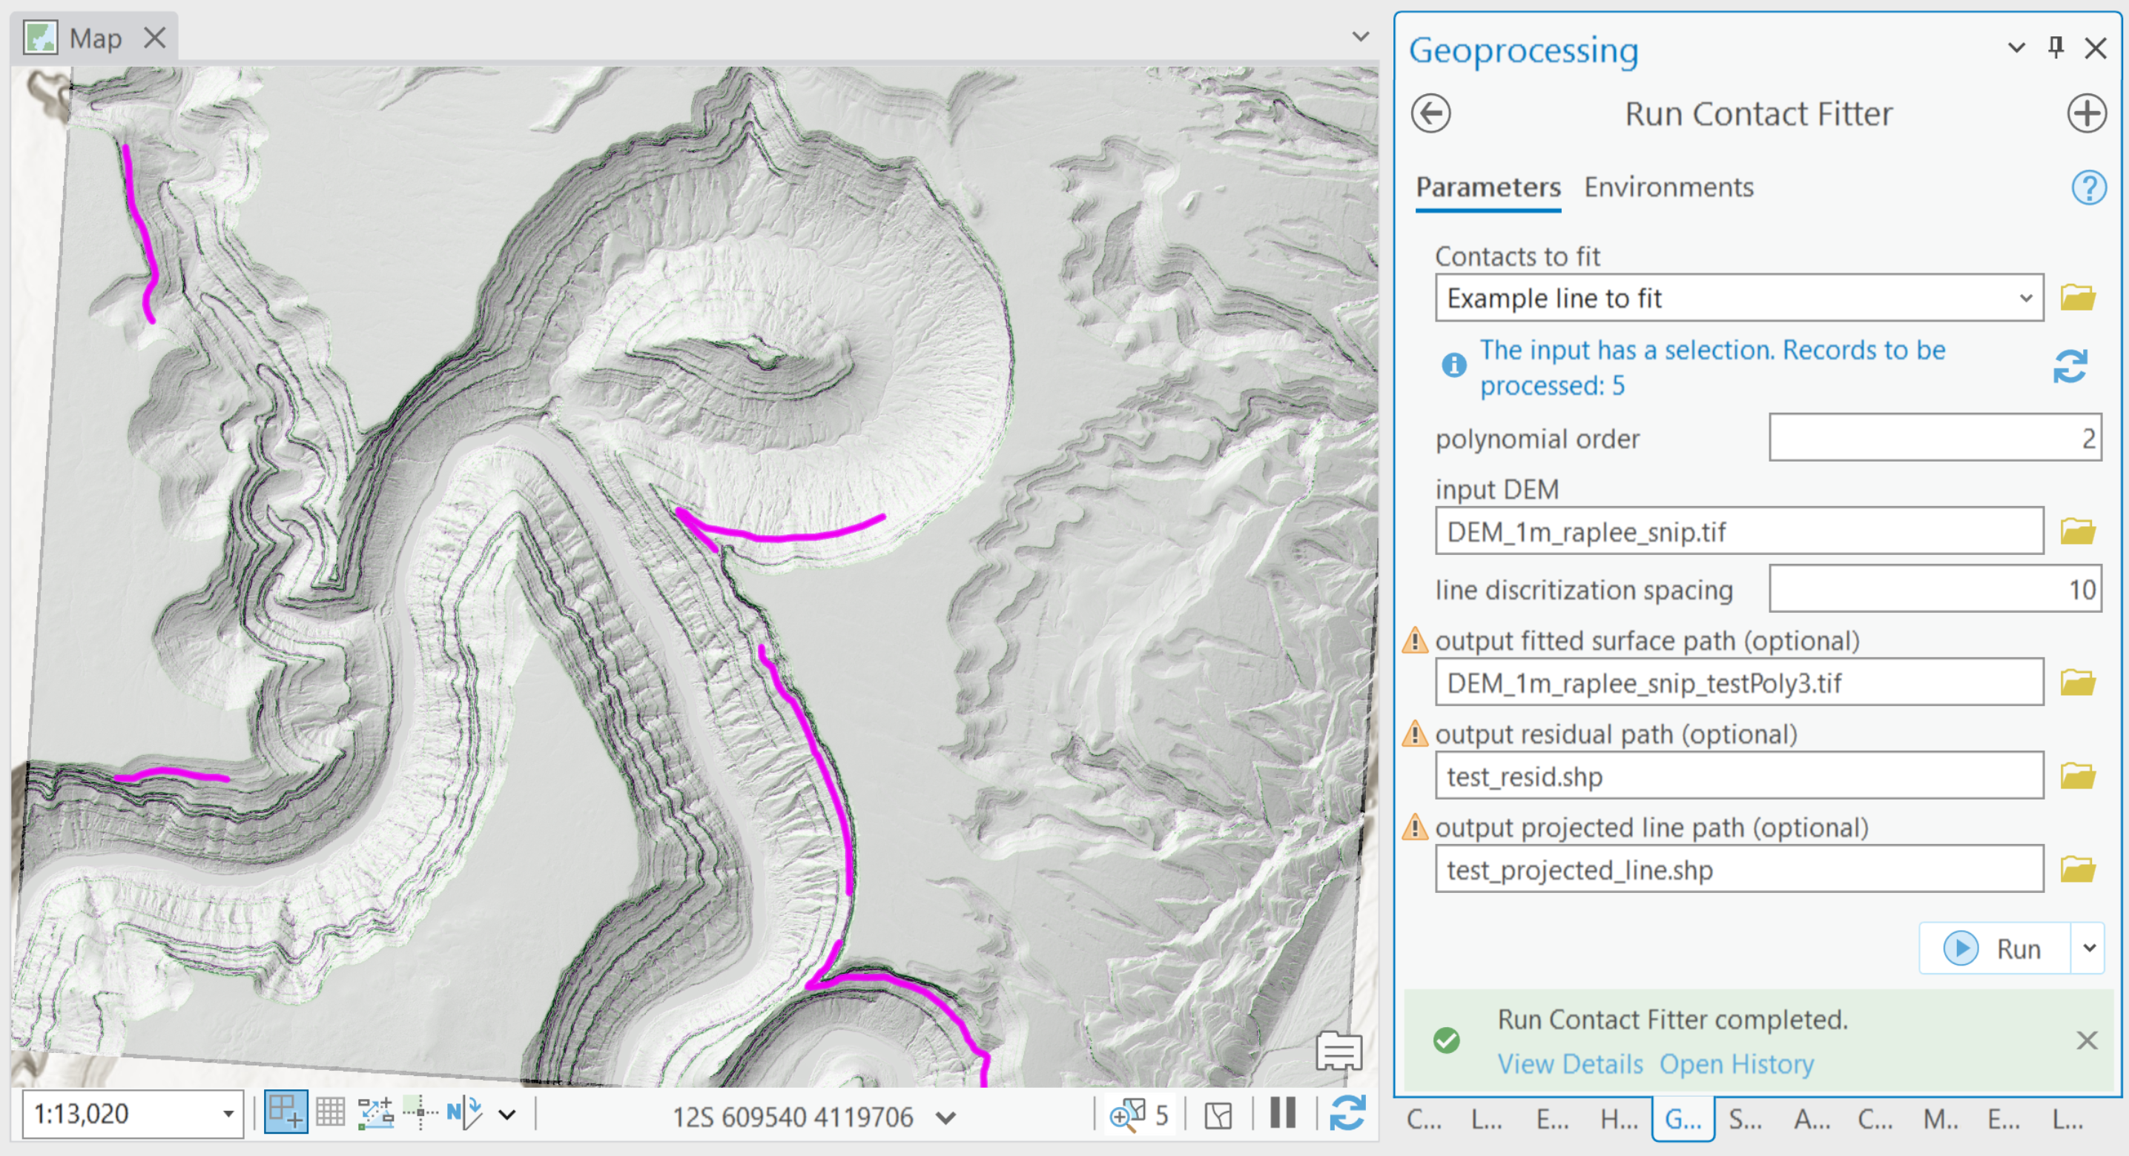
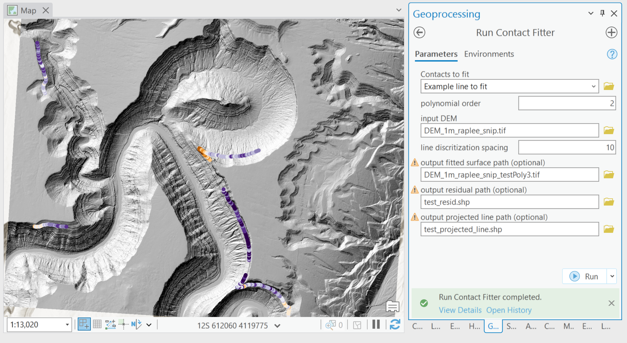
These ‘tools’ are python code bases that can generally be run as stand-alone modules or used within familiar software packages. This tool fits surfaces and projects contacts.
code.usgs.gov/atan/geologic_contact_fitter

Slide 5
Quinn Miller
Providing easier
access to digital elevation models and derivatives, topographic analysis and clustering of alluvial fans
Emma Rahalski
Inventorying landscape features with a ML image classification pipeline
Nessa Fakrai
Constructing complex relative chronologies in landslide inventories
Ollie Smith
Automatically characterizing and
mapping prominent stratigraphy

Slide 6
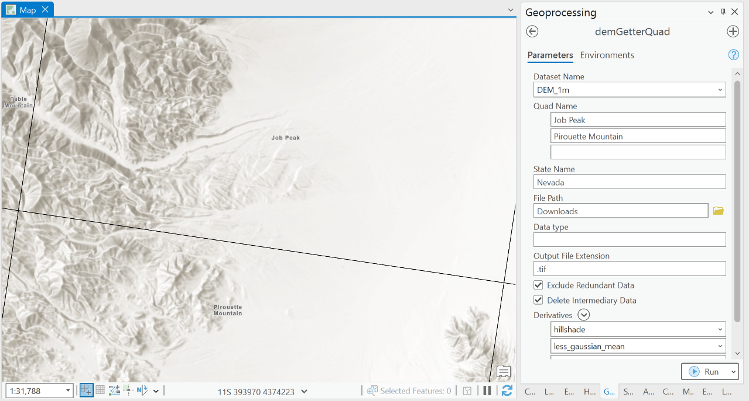
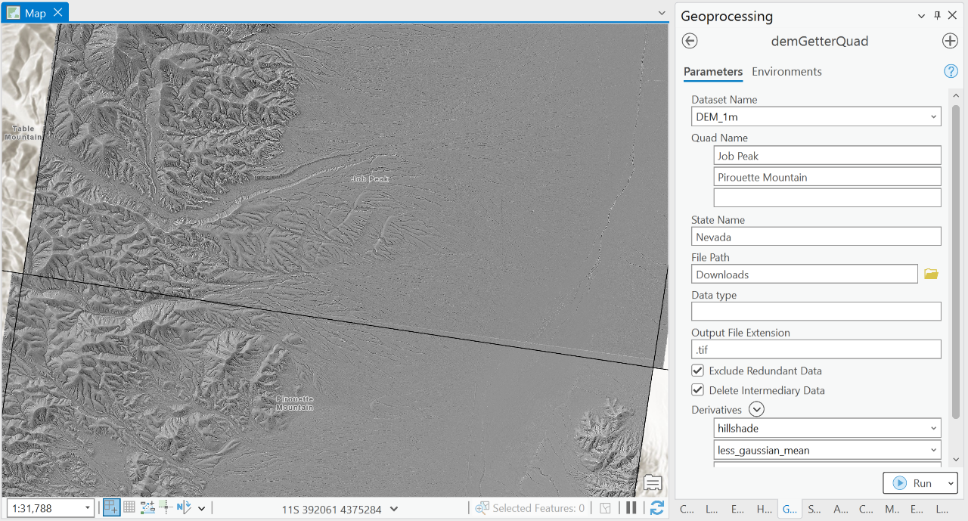
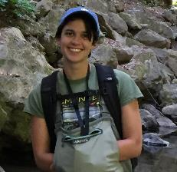
Quinn Miller
The dem_getter tool provides a one-stop shop for finding, merging, and visualizing digital elevation models.
code.usgs.gov/gecsc/dem_getter

Slide 7
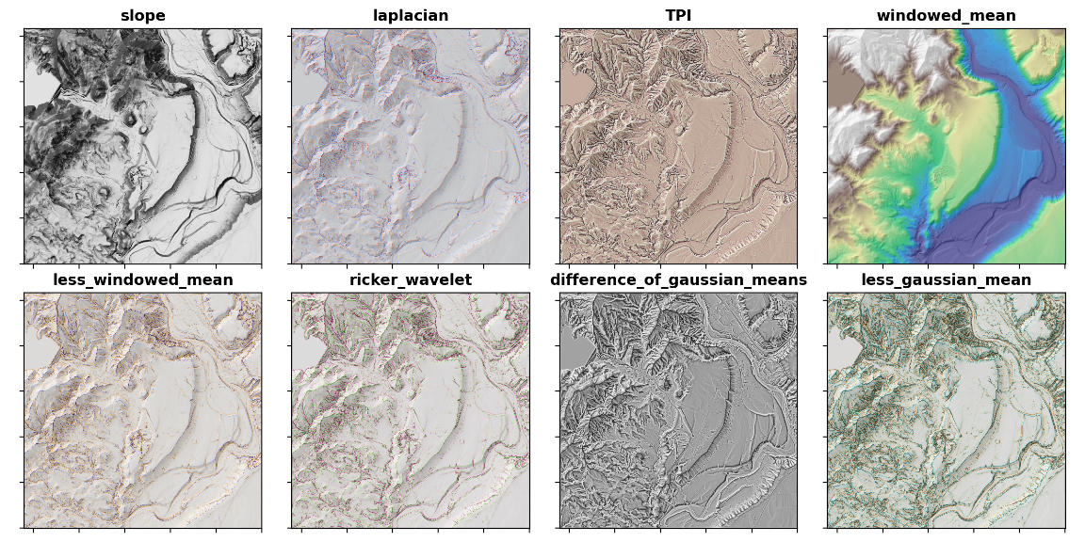
Around 15 feature-enhancing derivatives are currently available and more can be added based on interest.

Slide 8
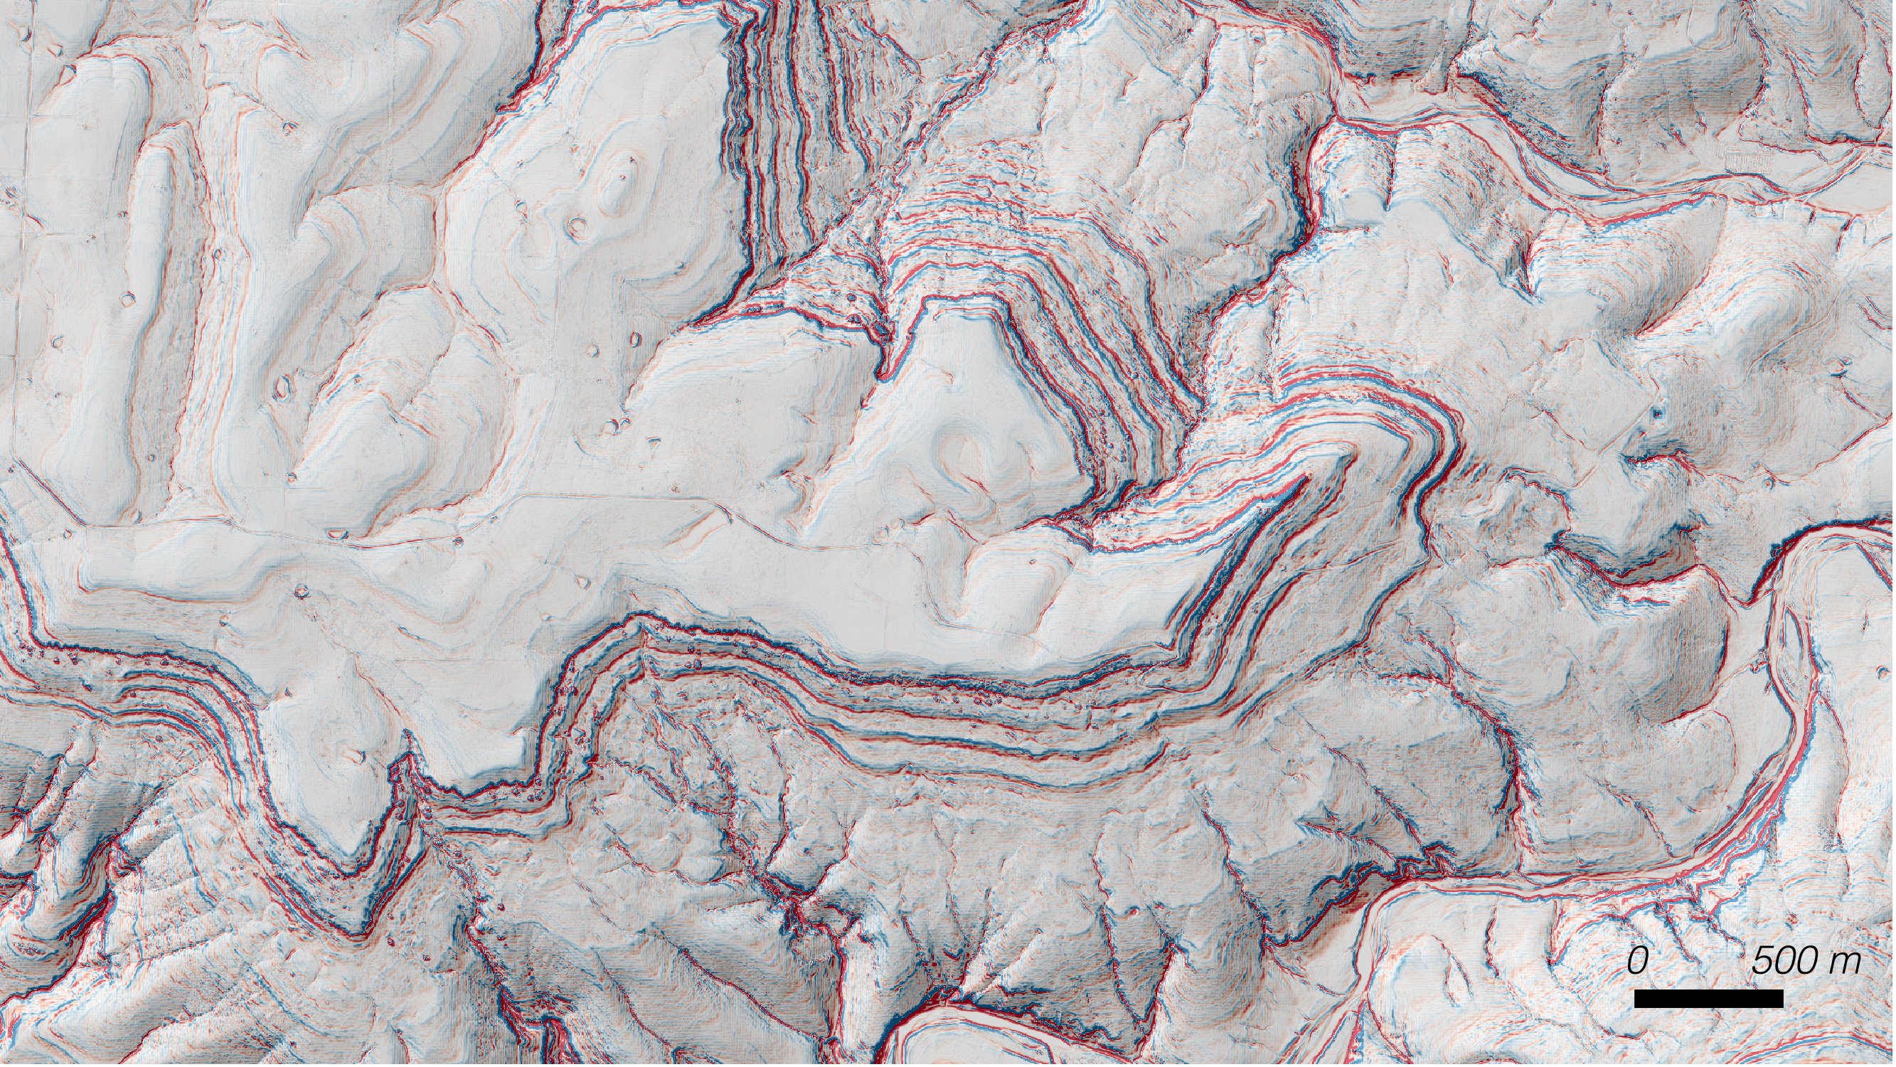
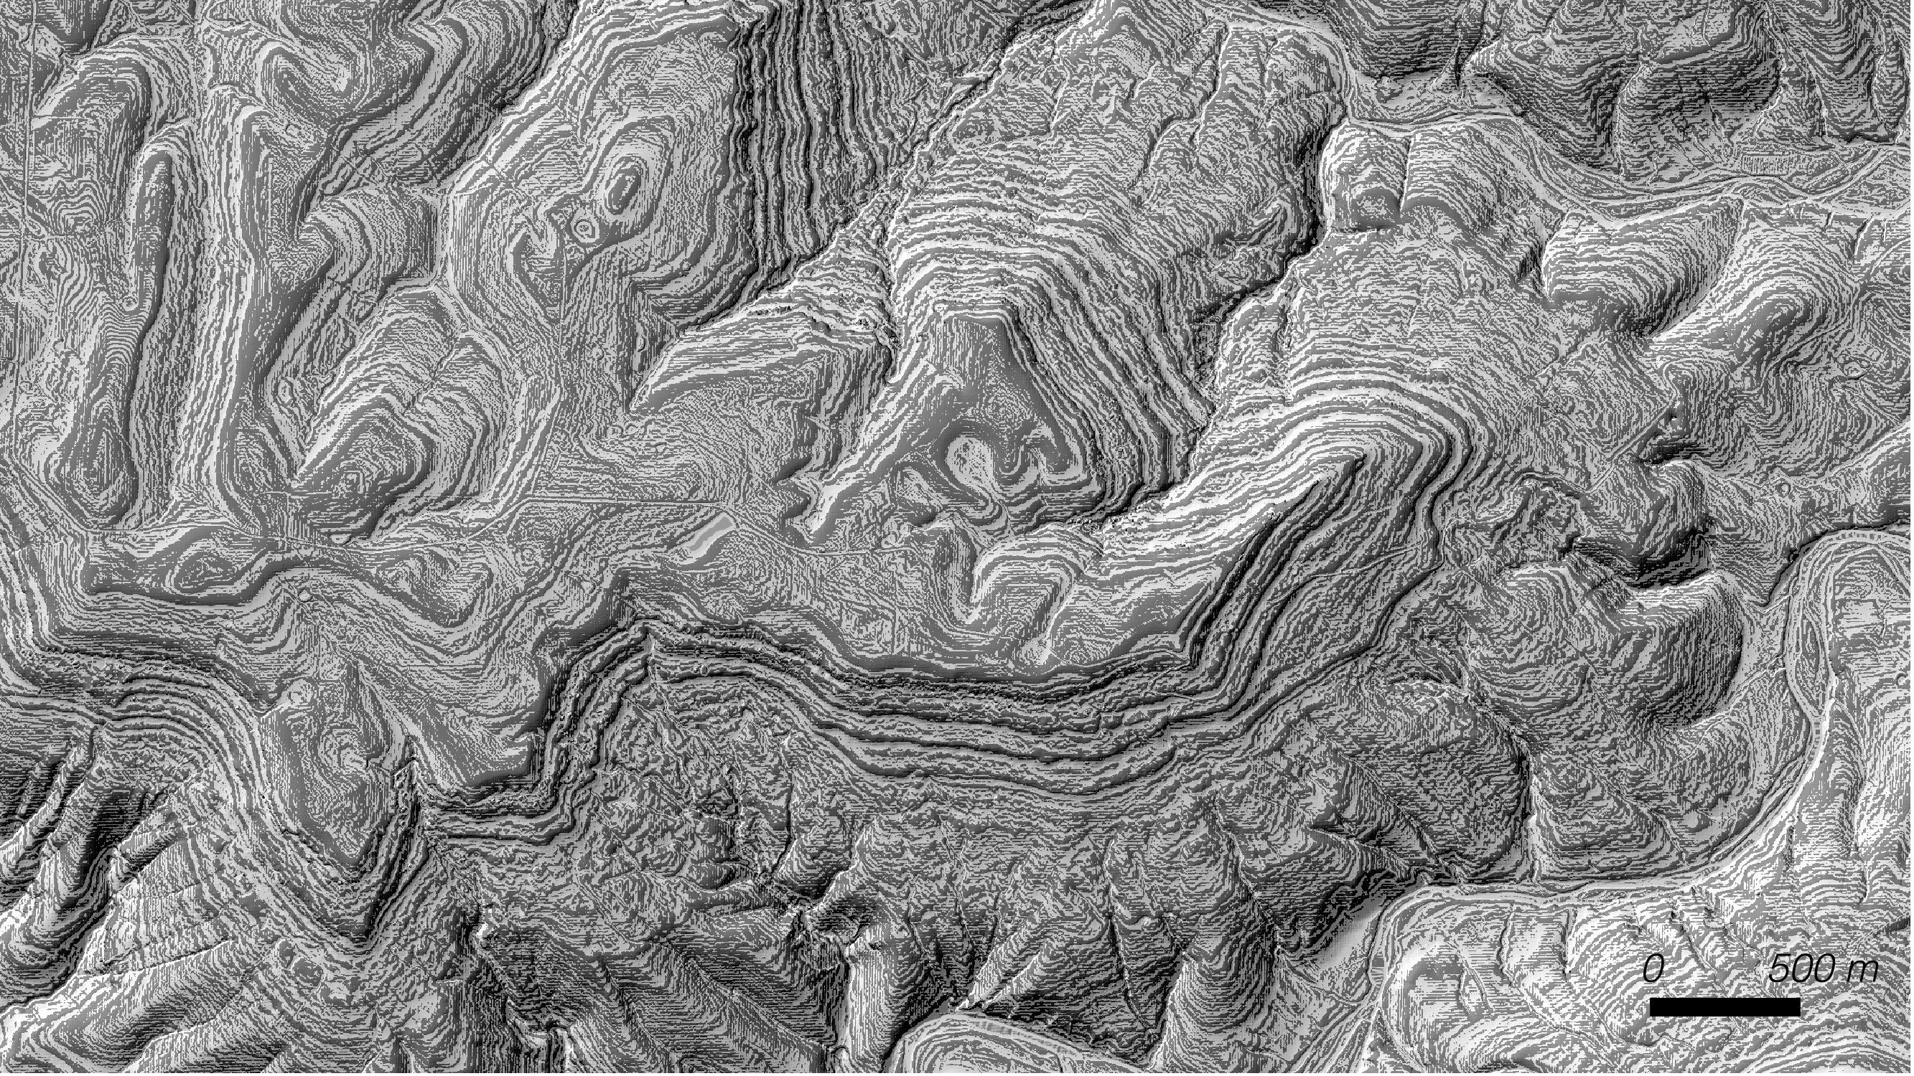
Can we read the barcode of hillslope form to recognize stratigraphic packages
Ollie Smith

Slide 9
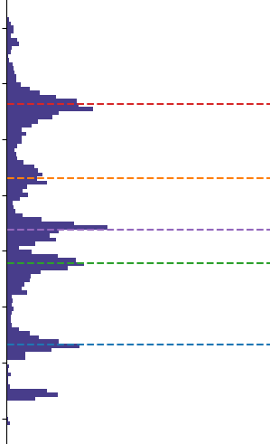
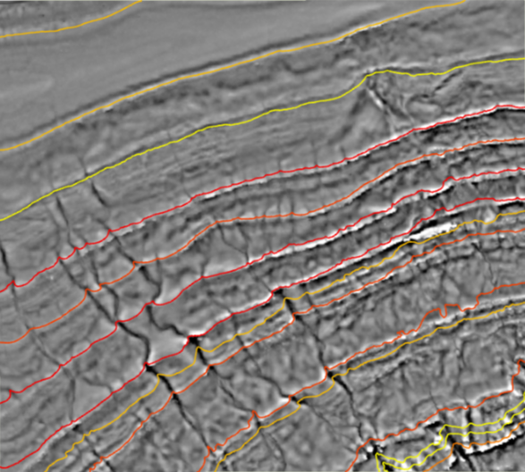
We can identify parts of the landscape that are ‘ledgey’ and collapse these into a pseudo-stratigraphic column to identify prominent features
Means of prominent
clusters of ledges
Elevation (m)
Frequency of
‘ledges’

Slide 10
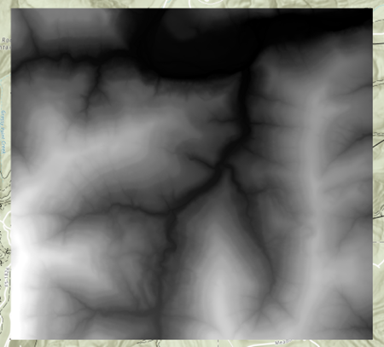
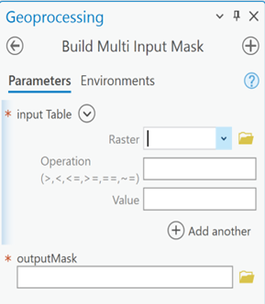
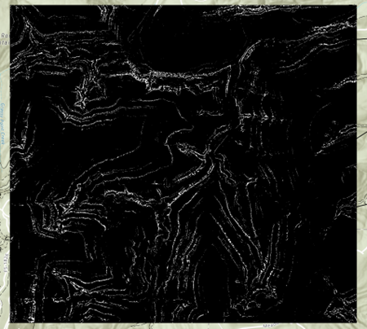
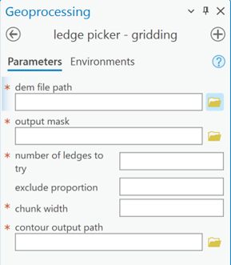
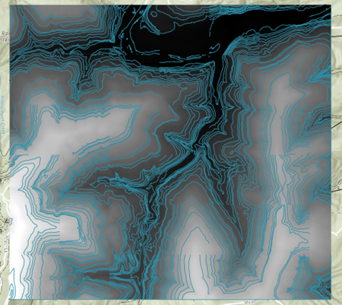
A set of tools in ArcPro make it easy to mask out ledged regions, march over large regions, and contour prominent ledges within regions

Slide 11
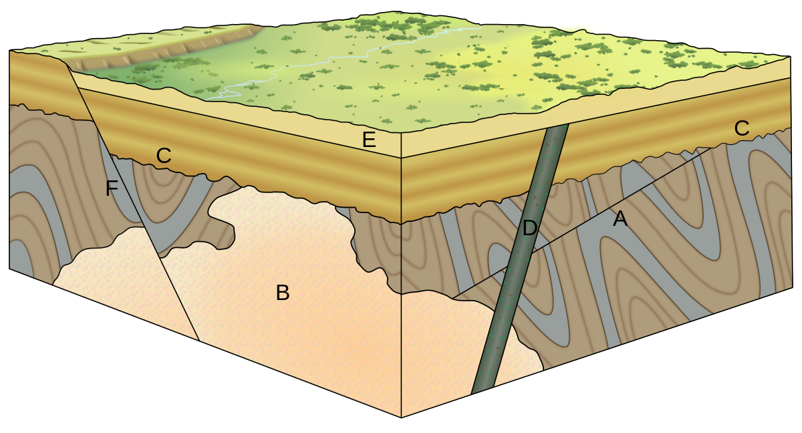
Directed graphs allow us to formalize and scale relative age relationships
Directed graph
Topological sorting
E
E
C
F
D
F
A
D
C
B
B
A
Ordered list of events
Observed relationships

Slide 12
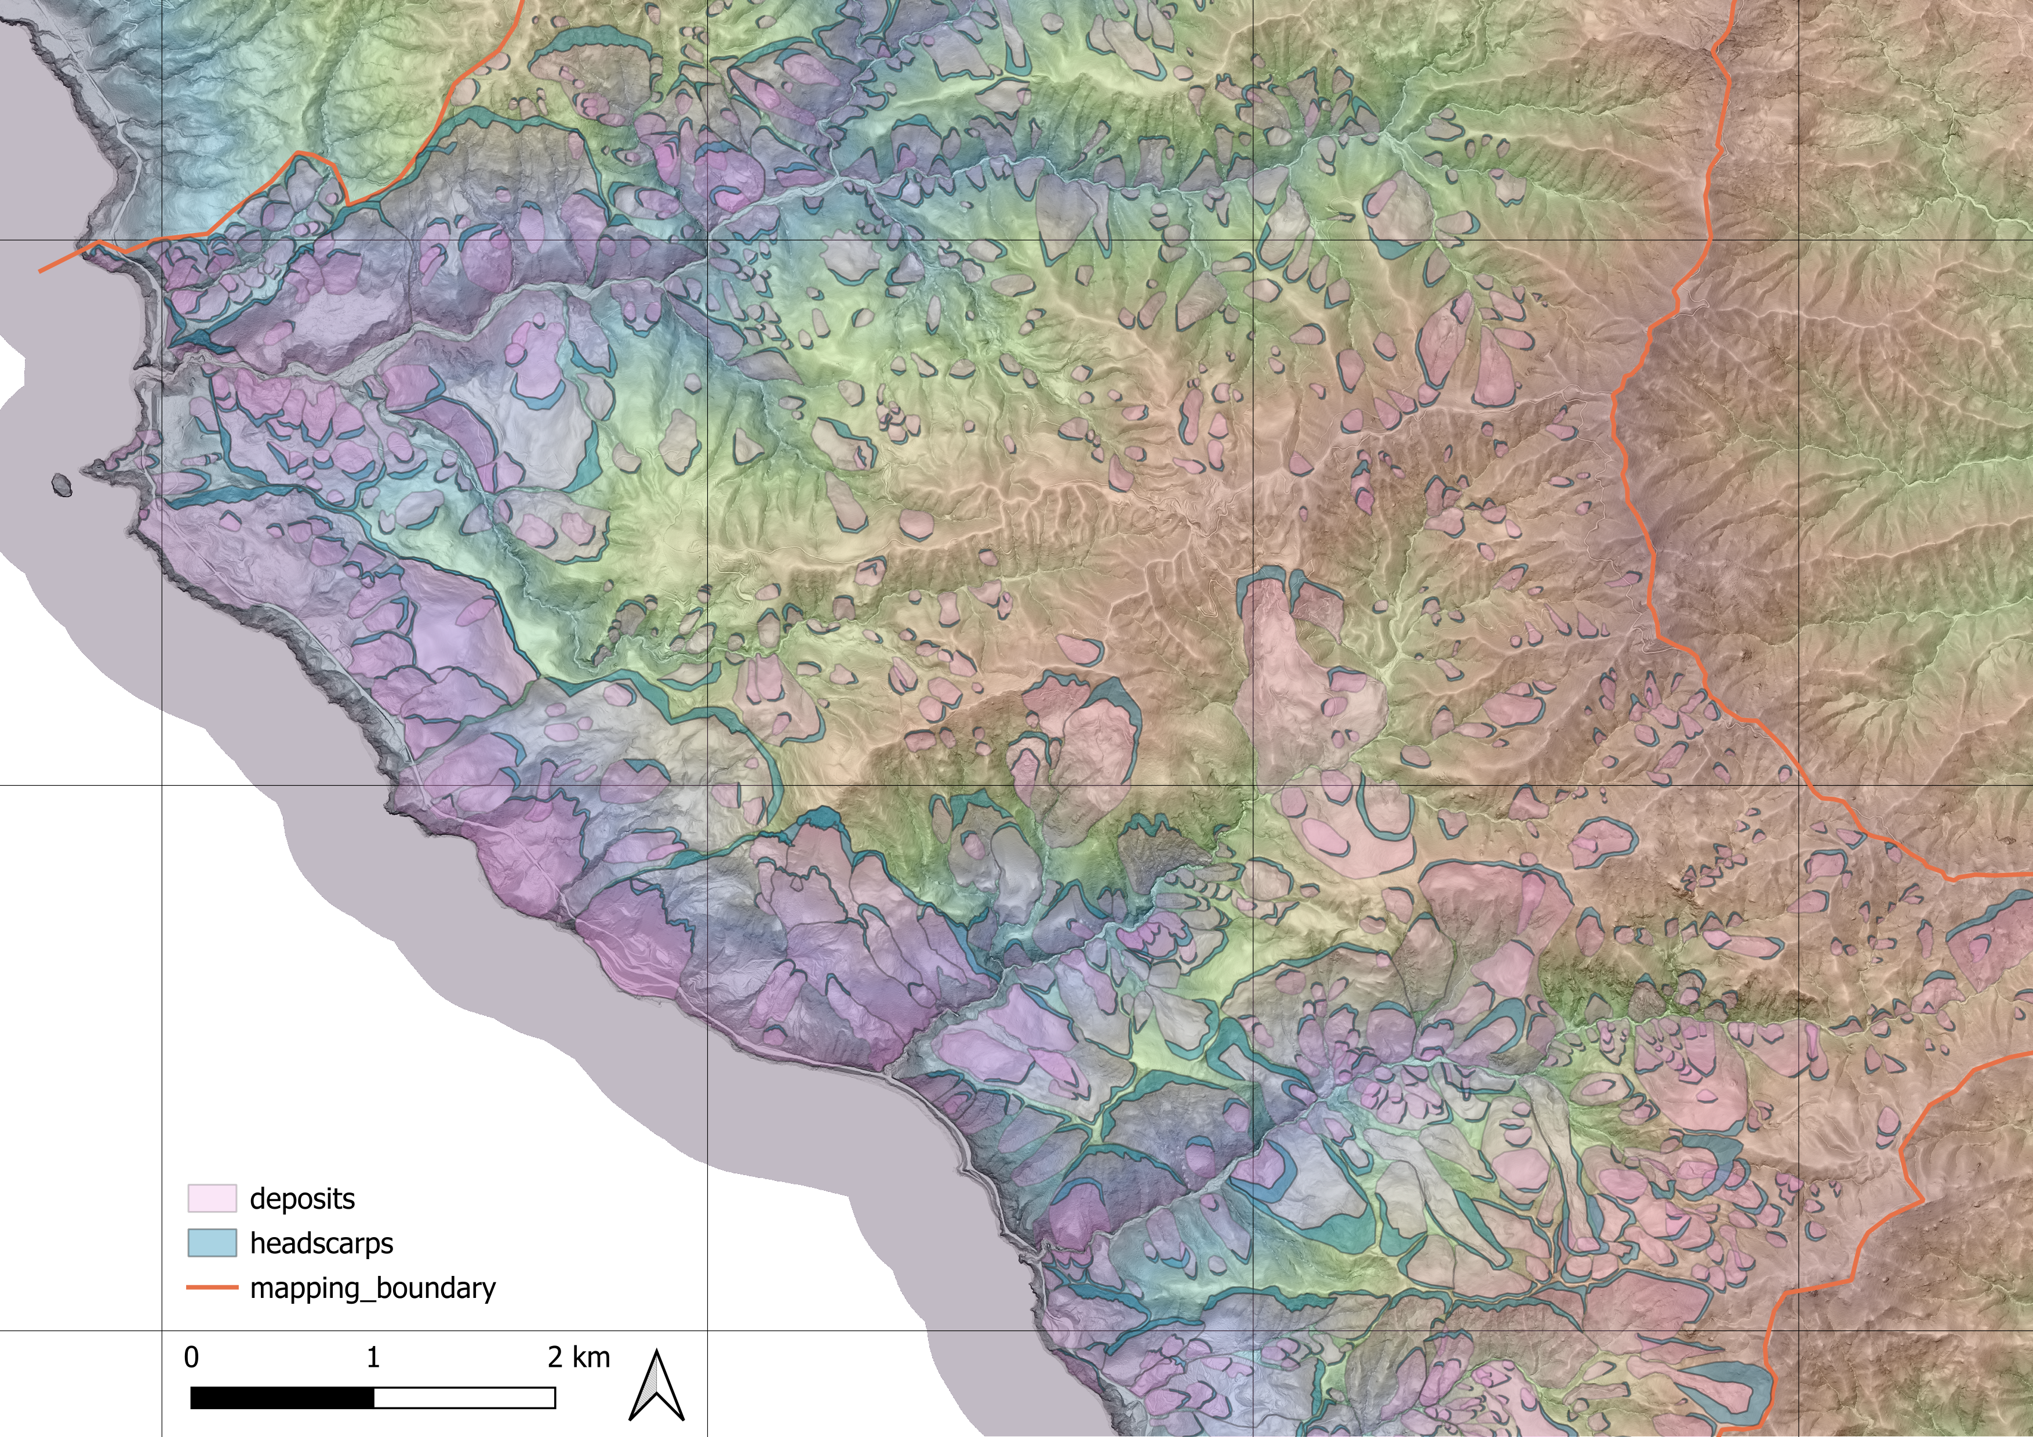
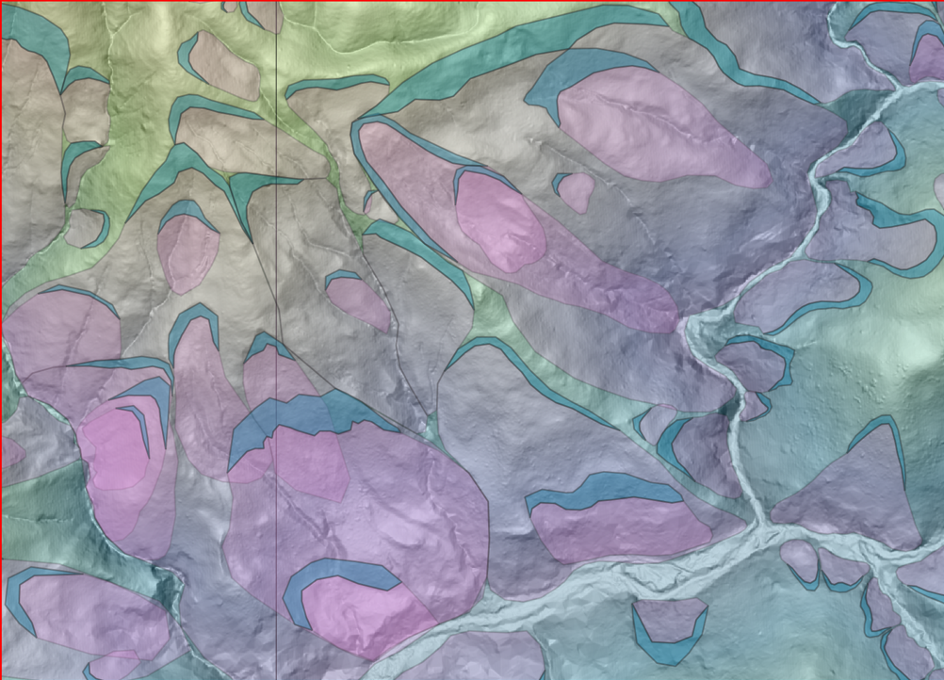
Mapping Landslides in Big Sur, CA
Nessa Fakrai

Slide 13
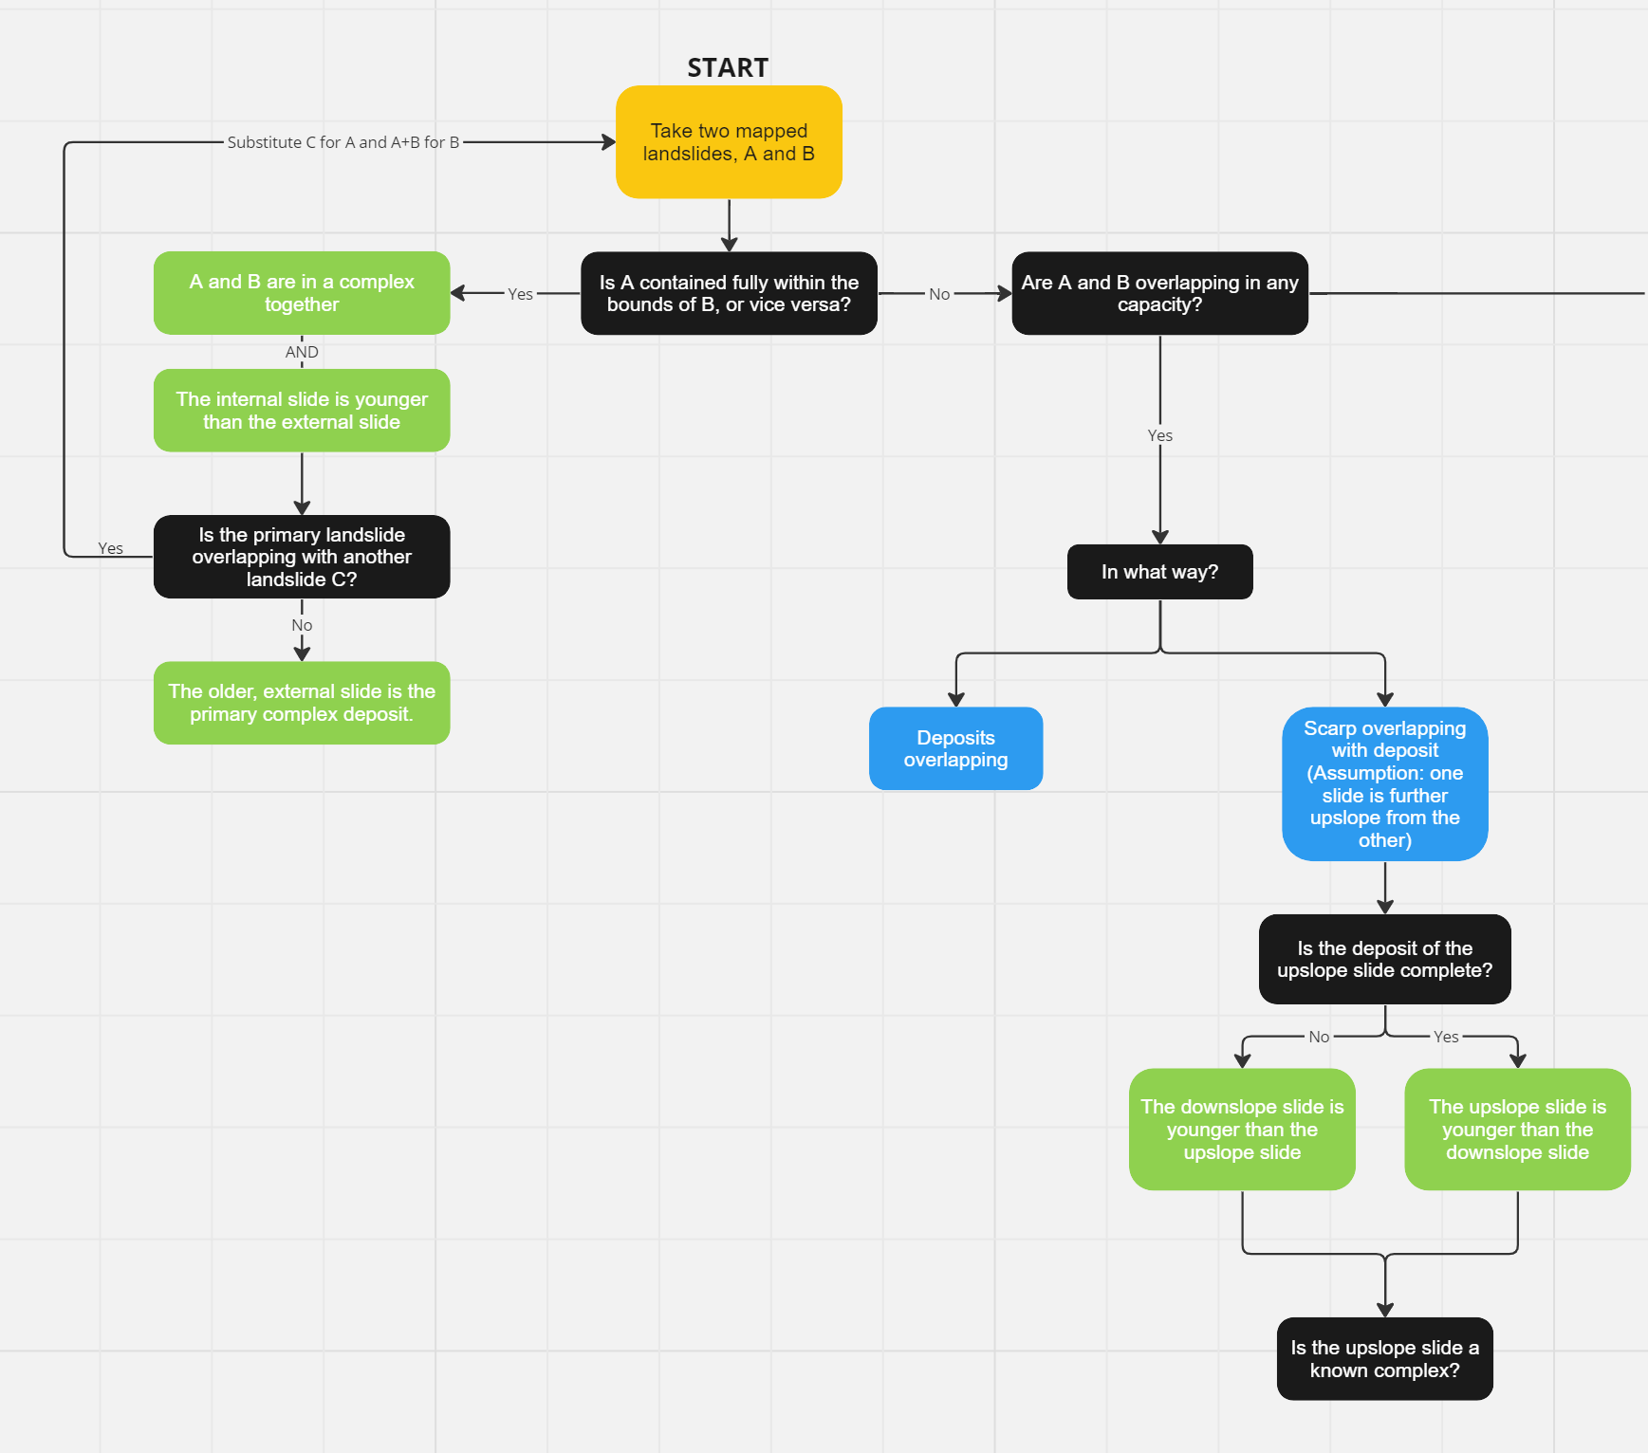
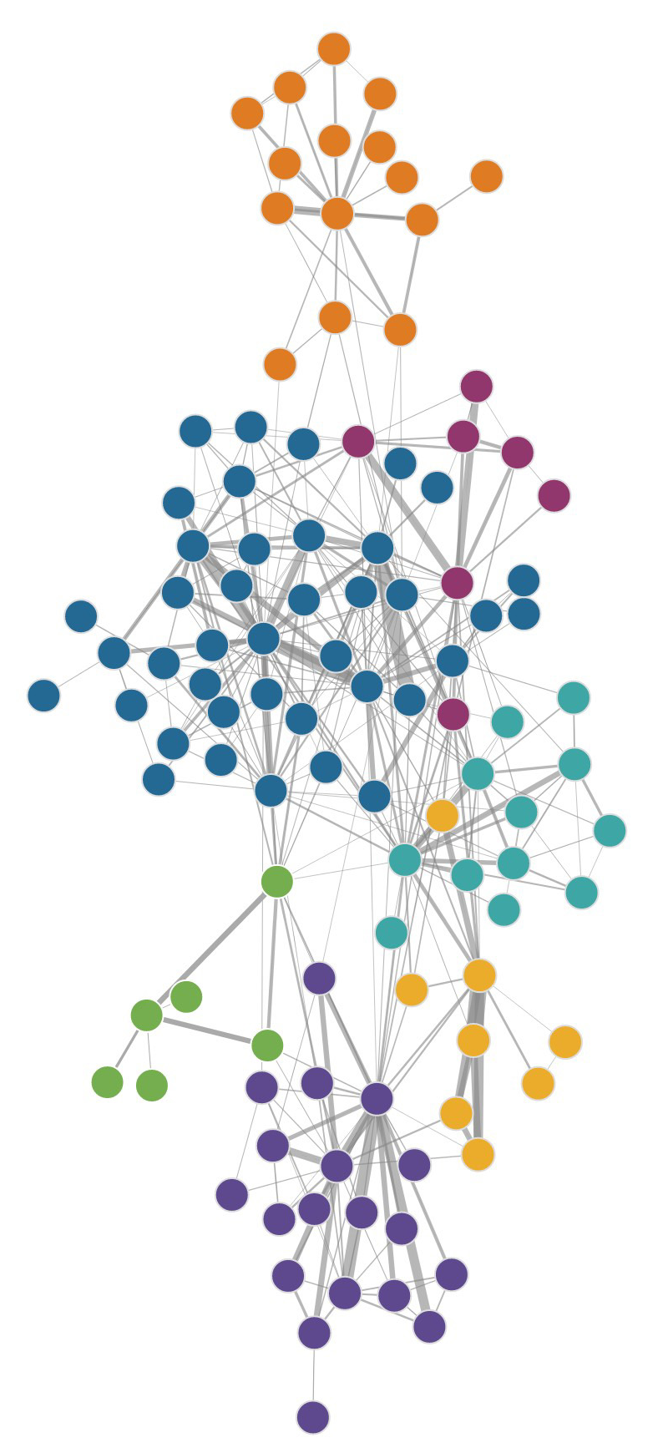
Detailed mapping of stratigraphic horizons is aiding in correlations of new age controls on the Lower Atoka in Arkansas

Slide 14
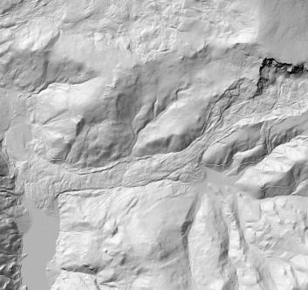
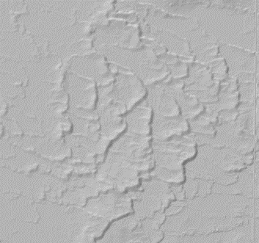
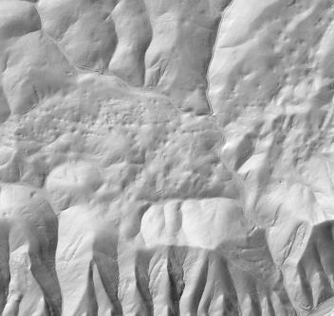
There are many landforms that we might like to efficiently inventory over large regions, without always needing to the exact extent of individual features

Slide 15
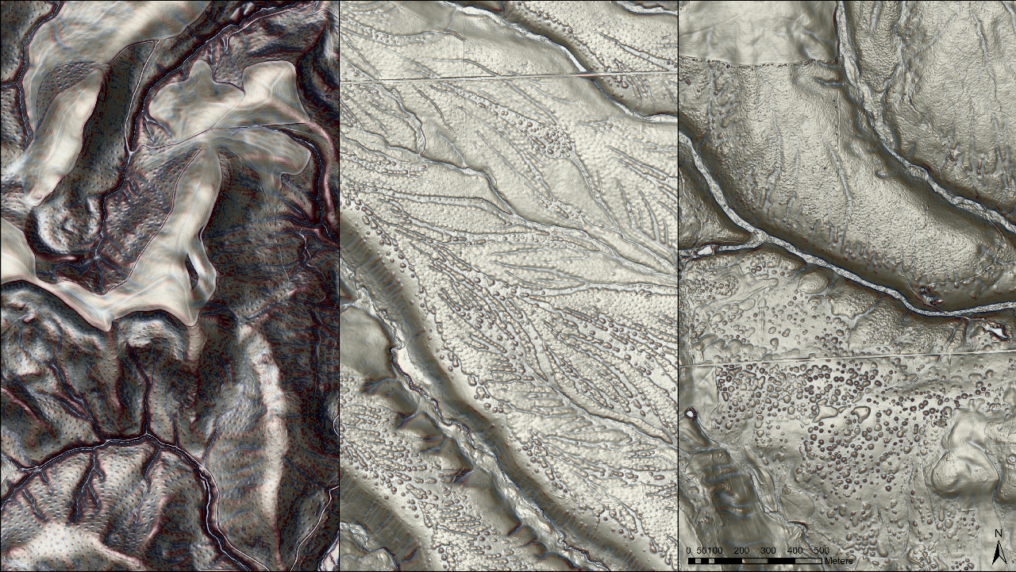
Classifying Mima Mound Presence in the Pacific Northwest
Emma Rahalski
Notes:
Image: 3 mound locations depicting ‘atypical’ mound behavior ~30 miles apart. Left is a few miles SE of The Dalles OR, right img is 30 miles east across the Columbia River in WA , middle image is 30 miles east of that a little farther north but still relatively close to the Columbia River.
‘Atypical Behaviors’
Left:: Not elongate on slopes
Middle: Odd compound mound behavior. Mounds on some kind of pediment surface aligned ~perpendicular to steep slopes.
Right: Uneven sized and irregularly spaced.

Slide 16
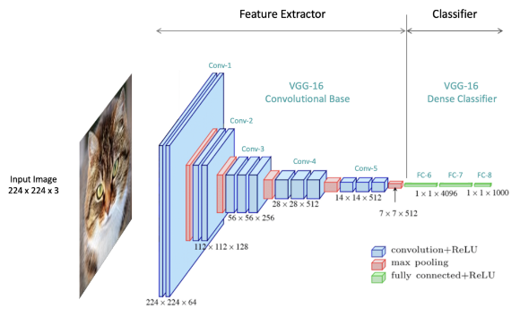
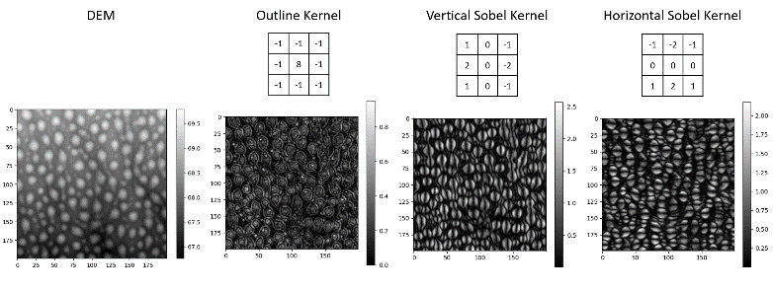
Why Convolutional Neural Networks (CNNs)?
CNNs scan gridded input data, performing matrix operations to extract features.
Commonly used for object detection in images.
Source: LearnOpenCV
https://learnopencv.com/understanding-convolutional-neural-networks-cnn/
DEMs share a structure similar to grayscale images.
This similarity allows for the application of CNN techniques to high-resolution elevation data.
Source: Explained Visually (Setosa)
https://setosa.io/ev/image-kernels/
Notes:
Top Right Fig: Shows general structure of CNNs- convolutions extract features and the tail classifies based on feature stacks
Bottom First Fig: Depicts how convolutions can extract features in images
Bottom Second Fig: Shows similar feature extraction for DEMs

Slide 17
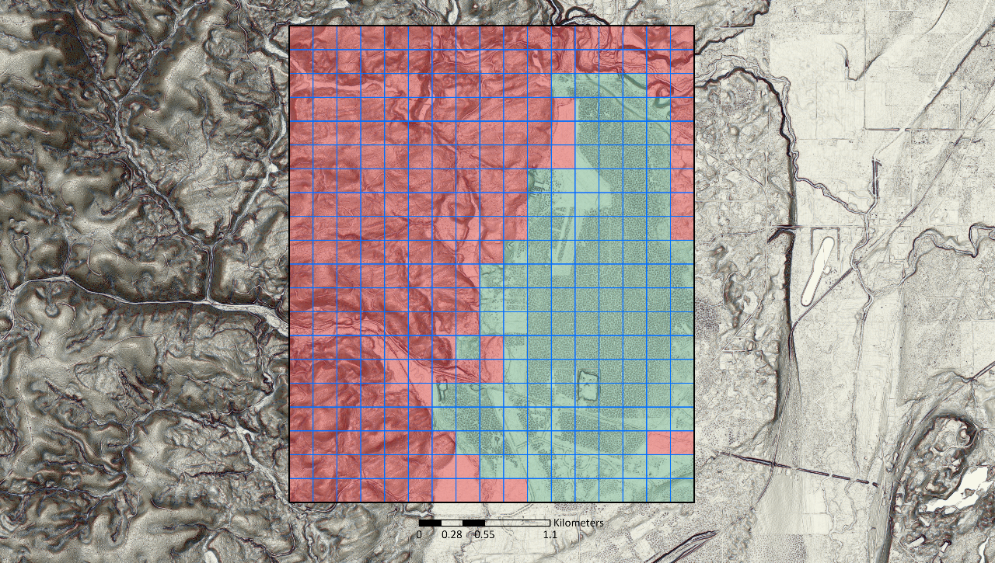
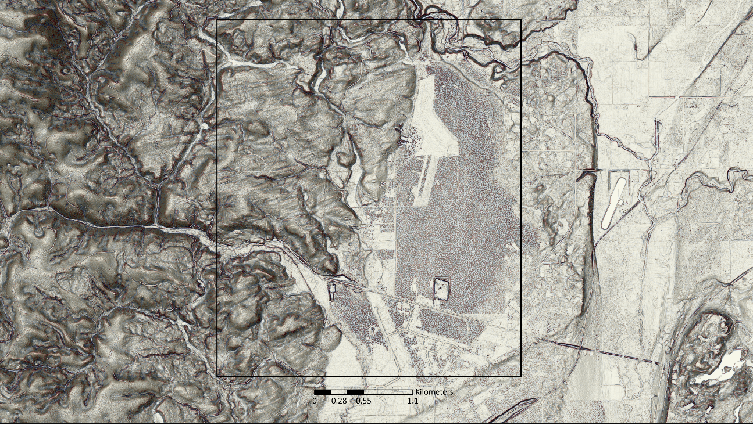
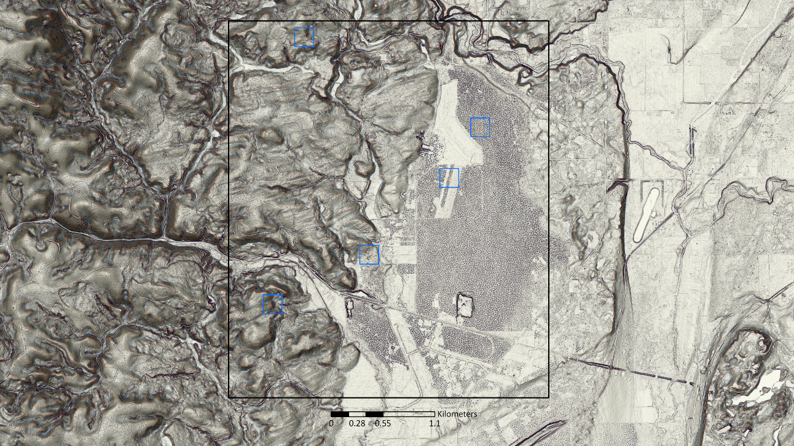
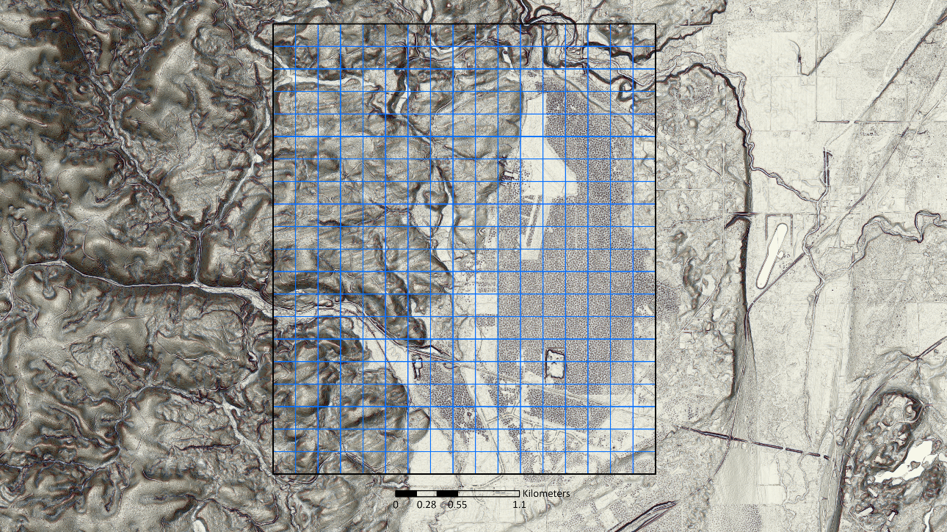
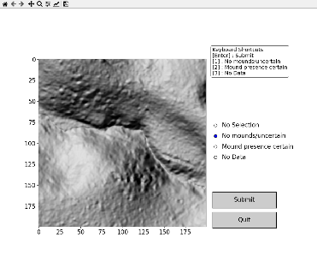
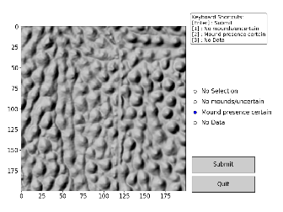
Mima Prairie (Thurston County, WA)
Lidar Label Builder
This tool streamlines the process of generating and labeling cropped areas to create training databases for object detection tasks
(e.g., detecting Mima mound presence)
Clips rasters to a grids or randomly placed squares
2. Prompts user to assign a label
3. Creates a database of DEMs and associated labels

Slide 18
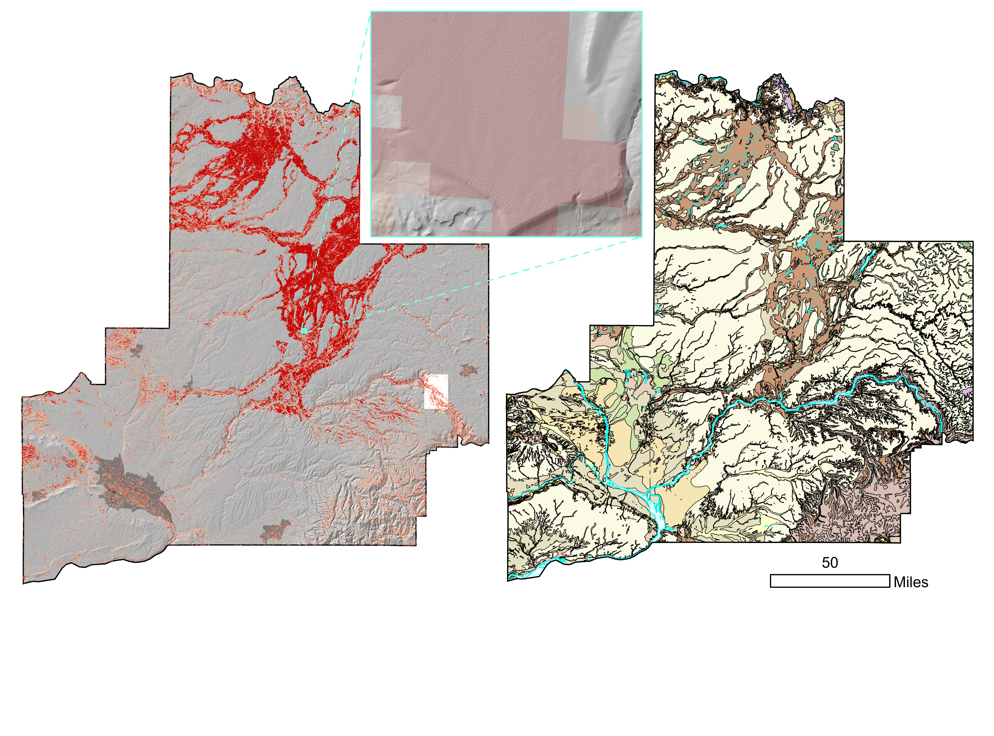
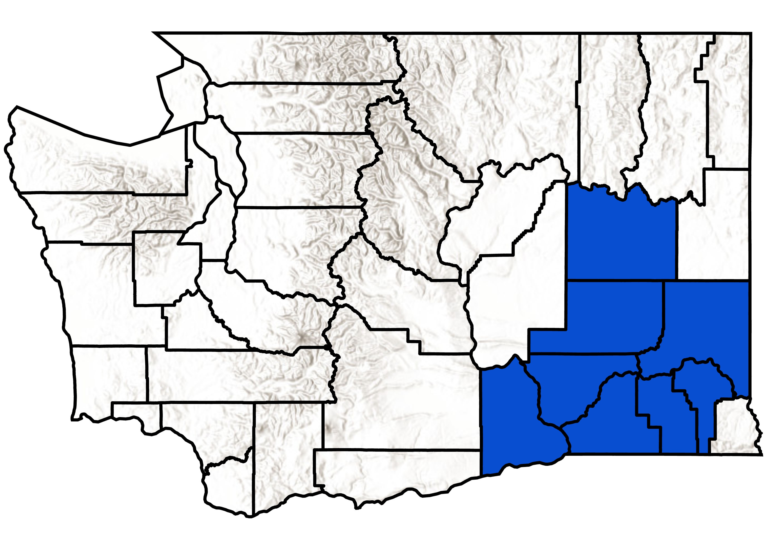
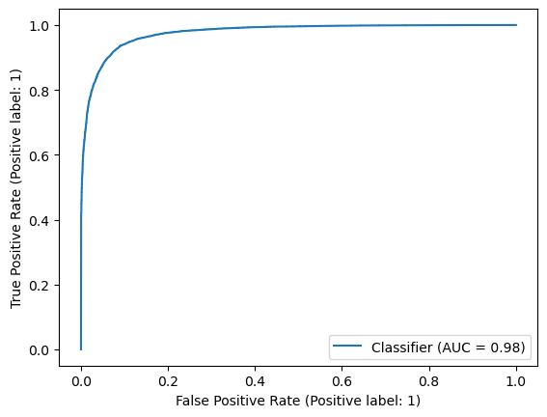
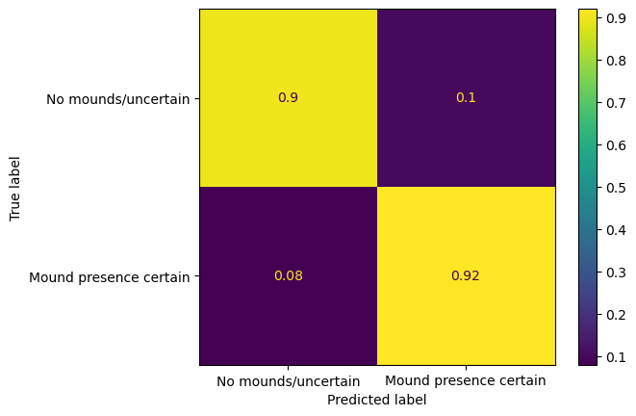
Auto-Mapped Mima Mounds, SW Washington
Deployment Area
32,092 km²
Time To Deploy
3 hours 15 mins
(Using parallel processing with 4 cores)

Slide 19
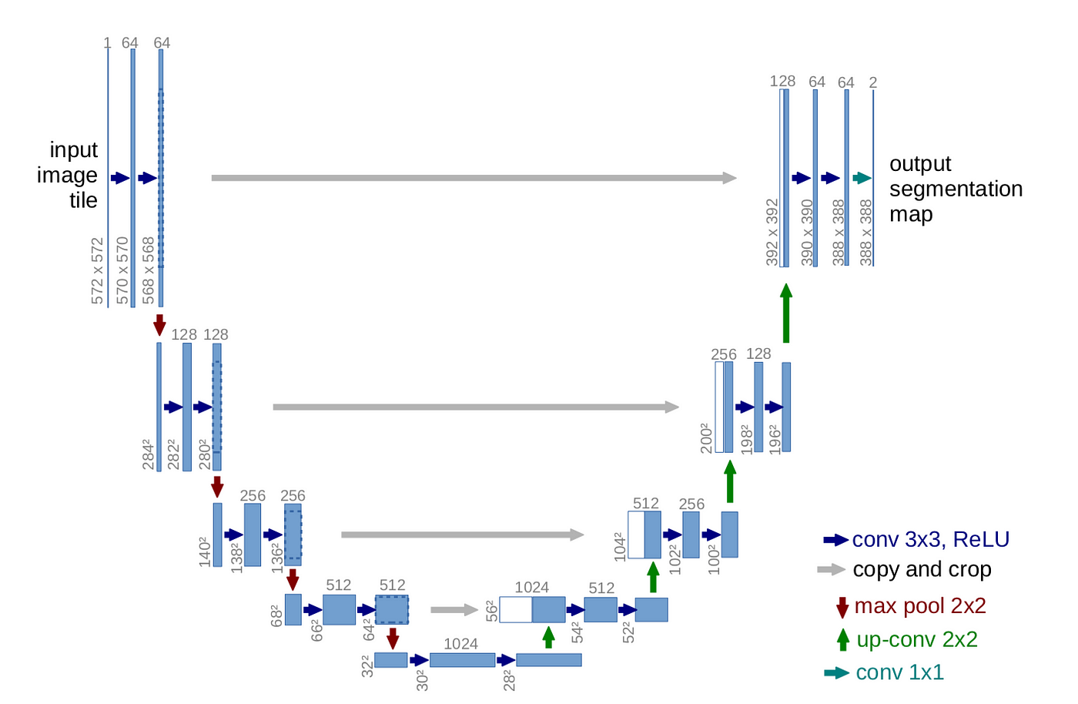
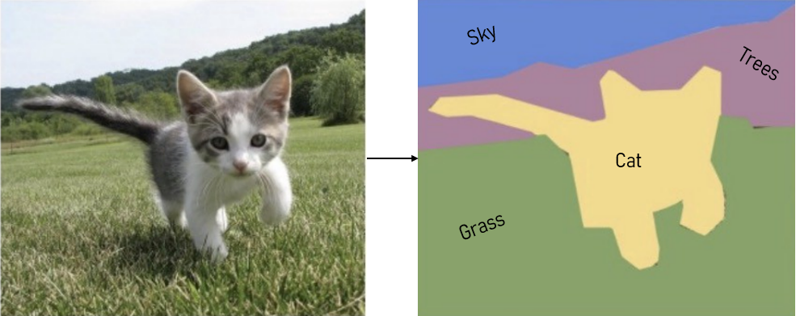
How is machine learning typically applied to map distinct regions?
Use that data to “train” a complex Neural Network like this “U-Net” architecture
Create a large store of training data demarcating the geology of interest
Deploy the trained model to new images to “segment” them
Work of Zhiang Chen, Chelsea Scott, Cassie Brigham (OpenTopography)

Slide 20
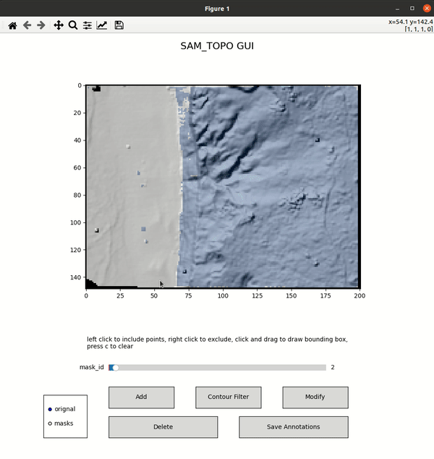
New developments in segmentation provide a glimpse of a different workflow that places a geologist ‘in the loop’
Prompting the model based on existing mapping
Newly segmented geology
Segment
Anything
Prompting the model based on user input
Work of Zhiang Chen, Chelsea Scott, Cassie Brigham (OpenTopography)
https://github.com/ZhiangChen/sam_topo

Slide 21
Drawing extensive Quaternary units is a common starting place in map construction.
This polygon took 258 clicks to crudely sketch in Powerpoint.
This video shows a similar, realtime, effort to draw this with ML ‘prompts’ provided to the Segment Anything Model.
This took 10 clicks.
Inclusion points
Exclusion points
Work of Zhiang Chen, Chelsea Scott, Cassie Brigham (OpenTopography)

Slide 22
Thank you!
Questions or interested in trying something?
Sam Johnstone, sjohnstone@usgs.gov

